Slide 1
Exploring the shapes of graphs using technology
Graphical representations

Slide 2
How our teaching resources are designed for the classroom

Slide 3
I can appreciate that different types of equations give rise to different graph shapes, identifying quadratics in particular.

Slide 4
The relationship between two variables is linear if, when plotted on a pair of axes, a straight line is formed.
A quadratic is an equation whereby the highest exponent of the variable is 2; the graph of which forms a parabola.
For example, x² + x is quadratic where as x³ + x is not.

Slide 5
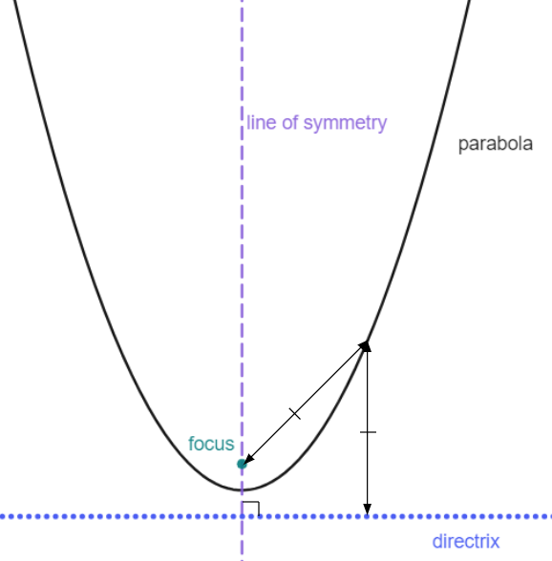
A parabola is a curve where any point on the curve is an equal distance from:
a fixed point (the focus), and
a fixed straight line (the directrix)
The line of symmetry goes through the focus, at right angles to the directrix.

Slide 6

Exploring the shapes of graphs using technology
Reviewing plotting graphs of equations
Plotting quadratic graphs

Slide 7
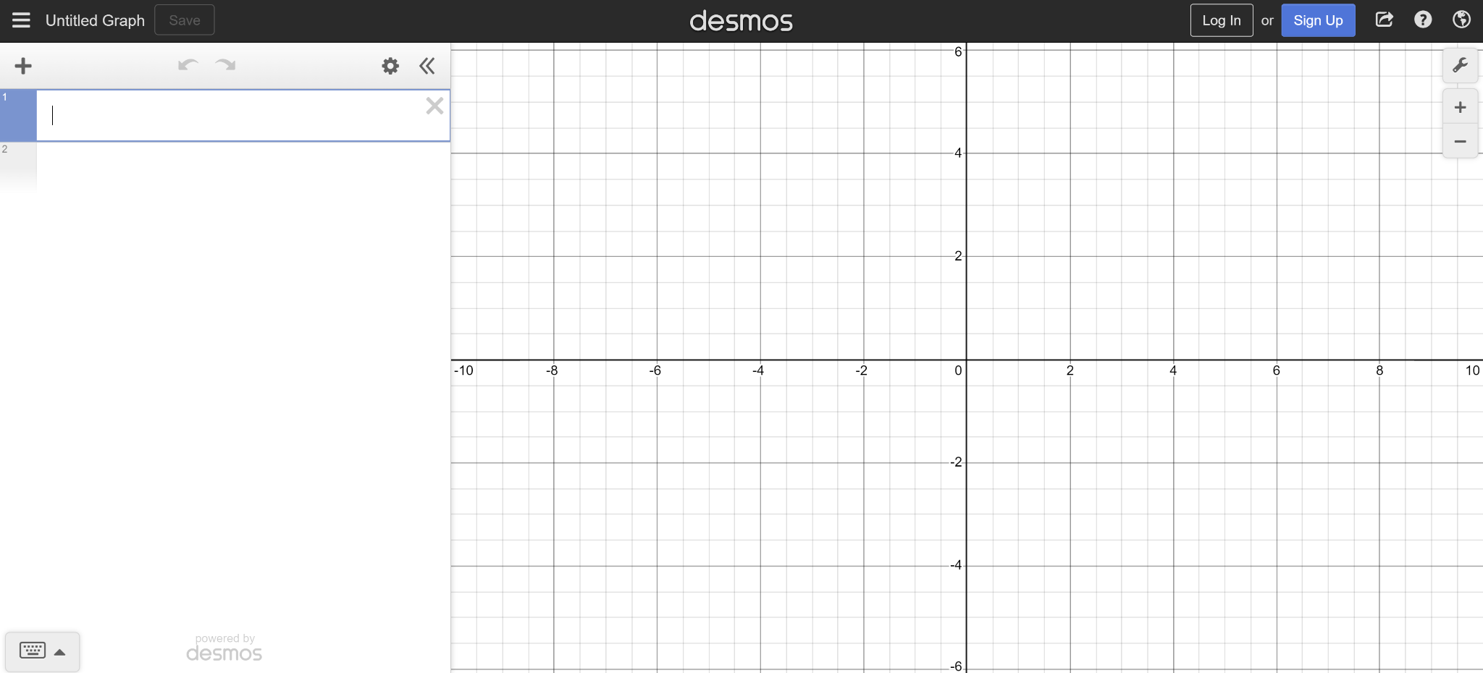
Reviewing plotting graphs of equations
To get started:
Open up a web browser and go to desmos.com
Find and press the ‘graphing calculator’ button
Your screen should look like this

Slide 8
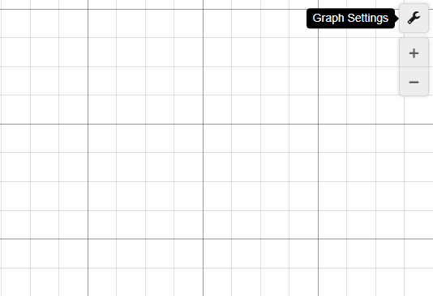
Reviewing plotting graphs of equations
Click on the ‘graph settings’ menu in the top right of your screen.

Slide 9
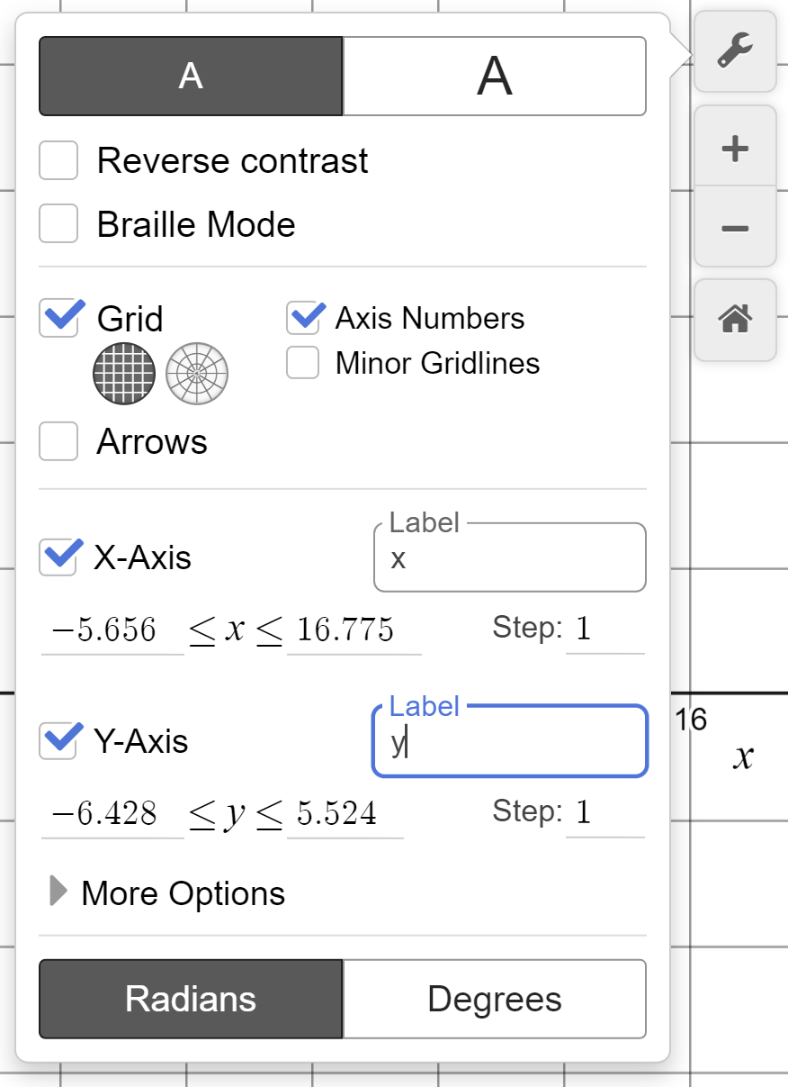
Reviewing plotting graphs of equations
The ‘graph settings’ menu should look like this.
Turn off ‘minor gridlines’
Type in ‘x’ in the x-axis label box
Type in ‘y’ in the y-axis label box
Change the ‘step’ on both axes to 1

Slide 10
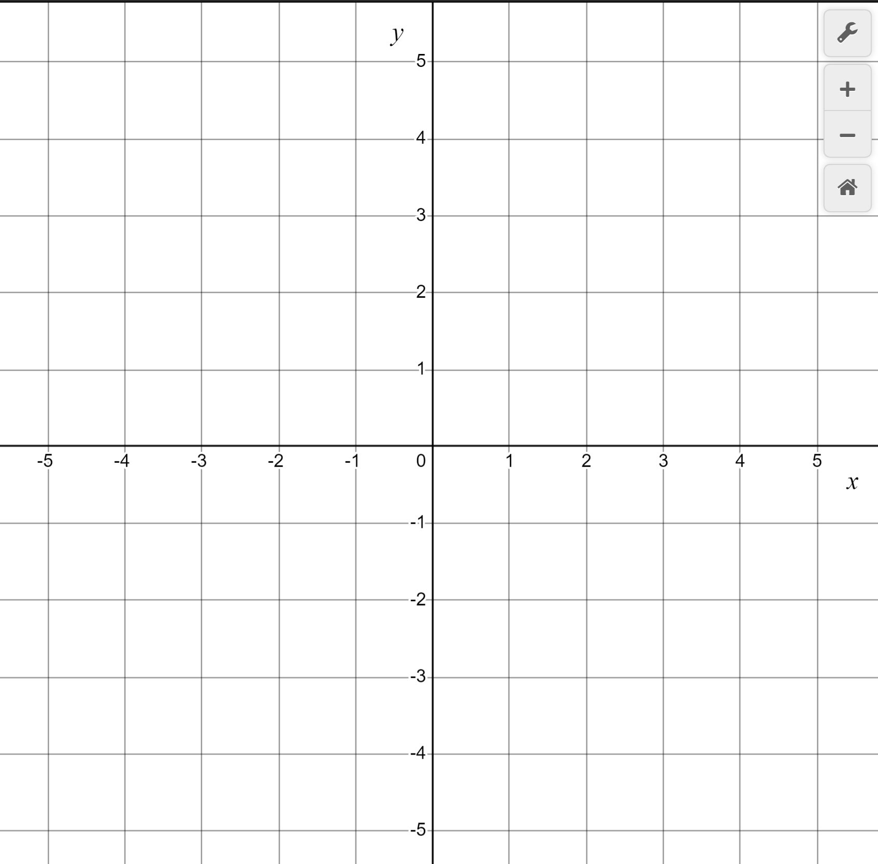
Reviewing plotting graphs of equations
You can zoom in and out using these +/− buttons
Alternatively zoom by holding shift, clicking and holding your mouse button, and moving the mouse back and forth
By clicking and holding the mouse button you can drag your axes around your screen

Slide 11
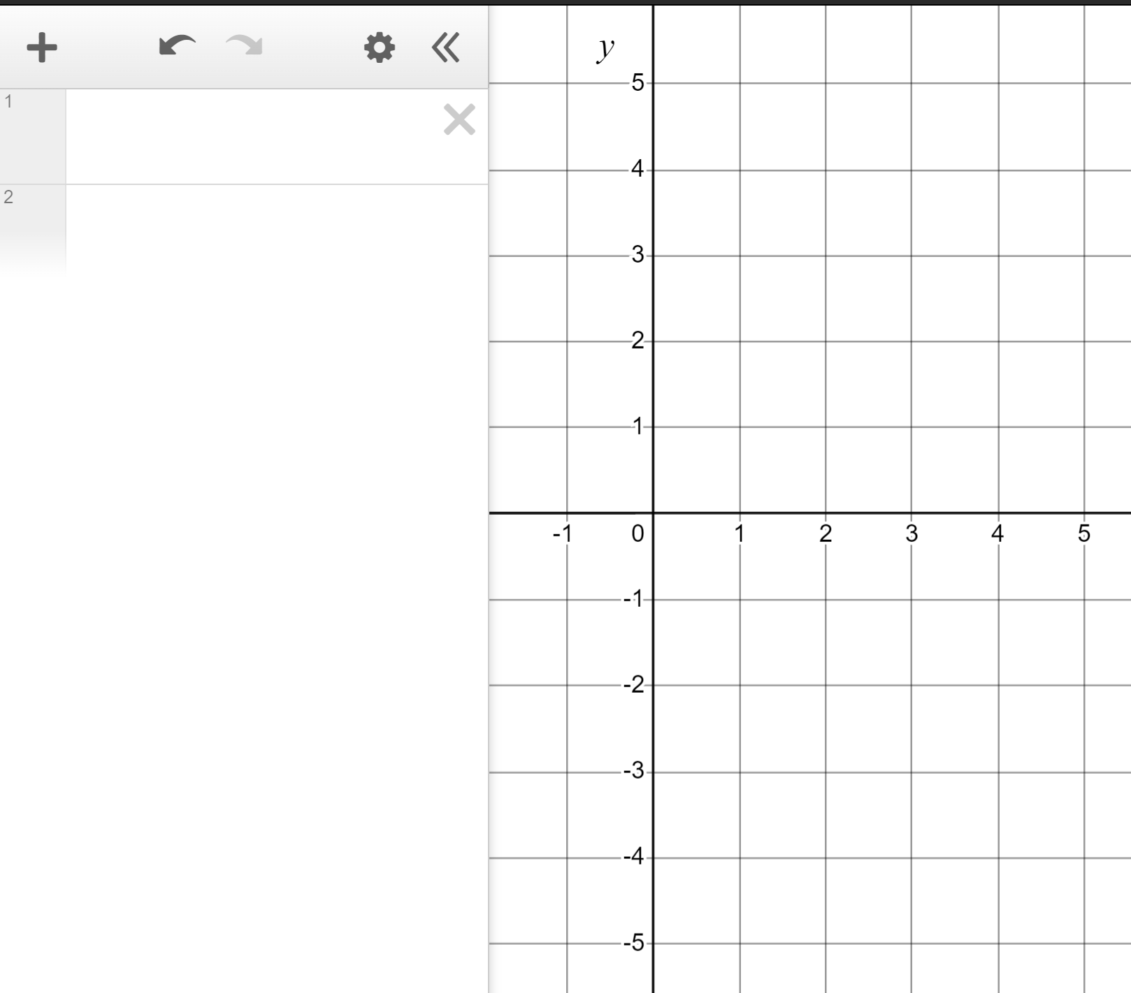
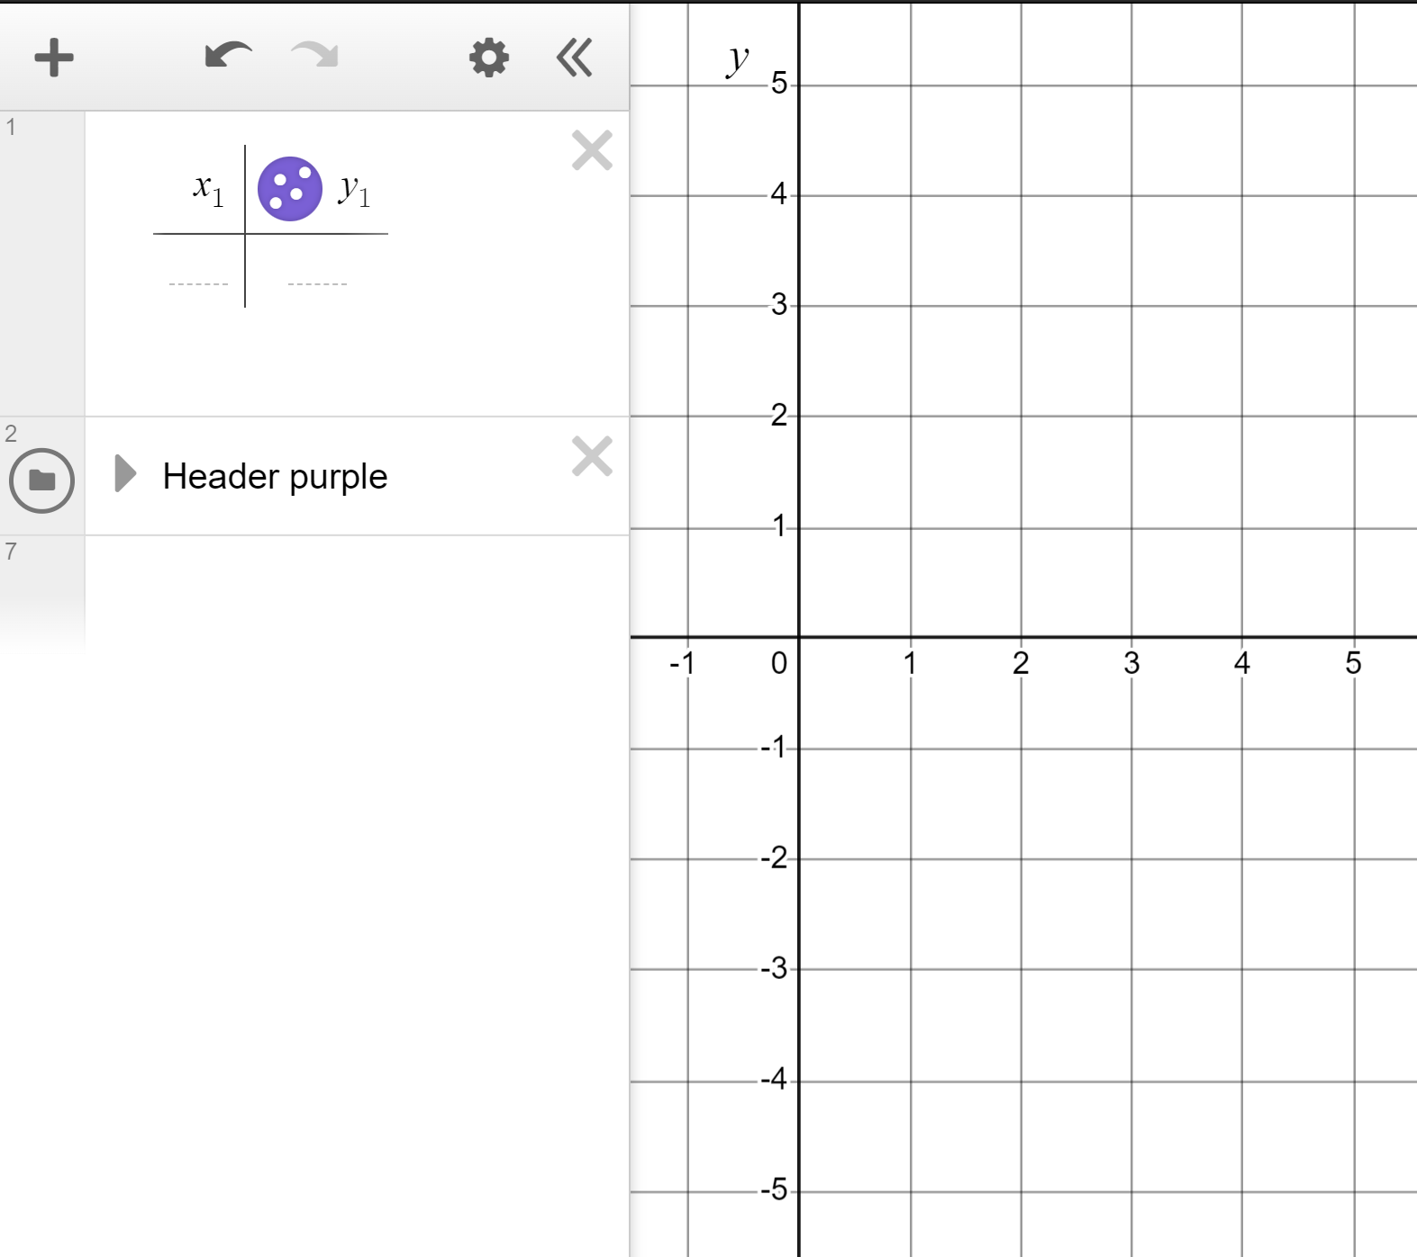
Reviewing plotting graphs of equations
We’re now ready to explore plotting graphs of equations.
Zoom and drag so your screen is scaled with −5 to +5 visible on the y-axis and 0 to +5 on the x-axis.
We’ll use the table function to plot our first graph so click on the ‘add item’ button and click ‘table’.
We can enter coordinate values into this table.

Slide 12
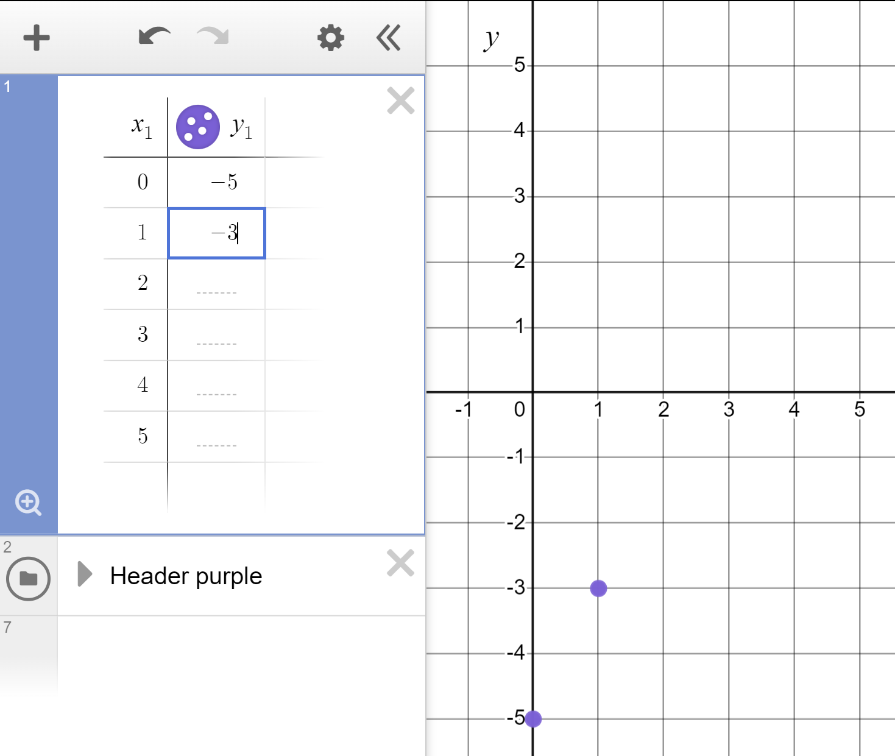
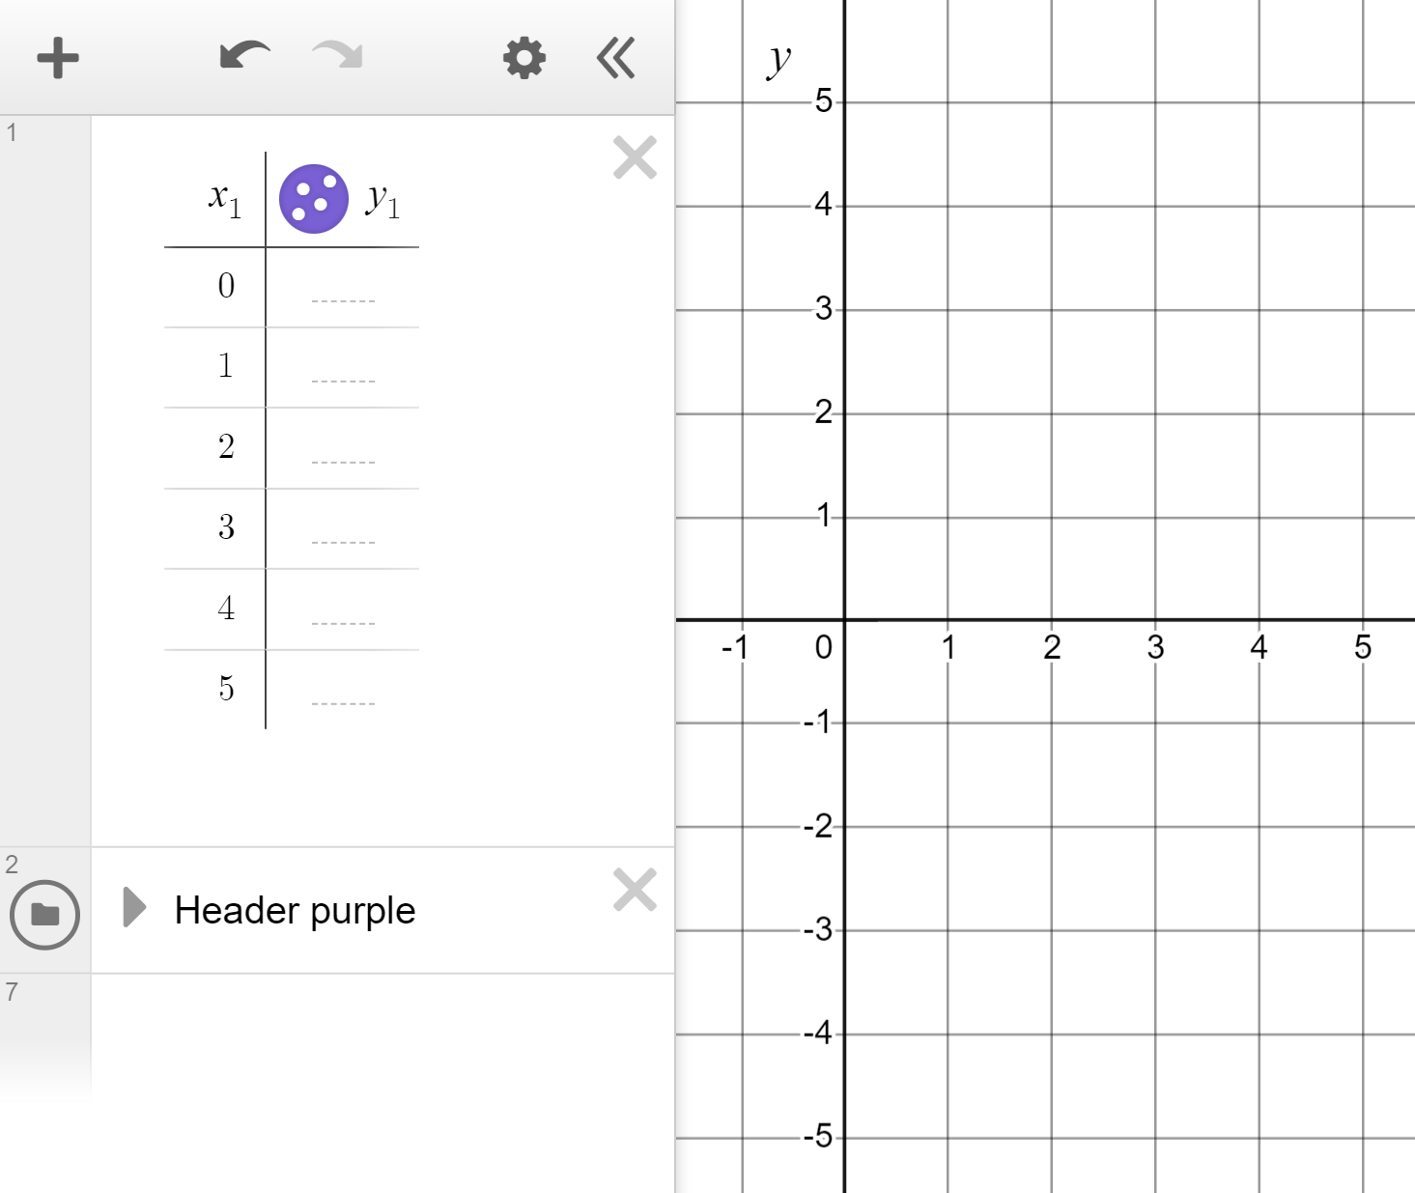
Reviewing plotting graphs of equations
Plot the linear graph of y = 2x − 5 for x-values in the range 0 to +5
Type 0 to +5 in the x column.
Hint: Hit ‘enter’ after typing 0 and 1
We need to find the respective y coordinate for these x coordinates.
When x = 0, y = 2(0) − 5 = −5
(0, −5)
When x = 1, y = 2(1) − 5 = −3
(1, −3)
Find the remaining y coordinates and add them to the table.

Slide 13
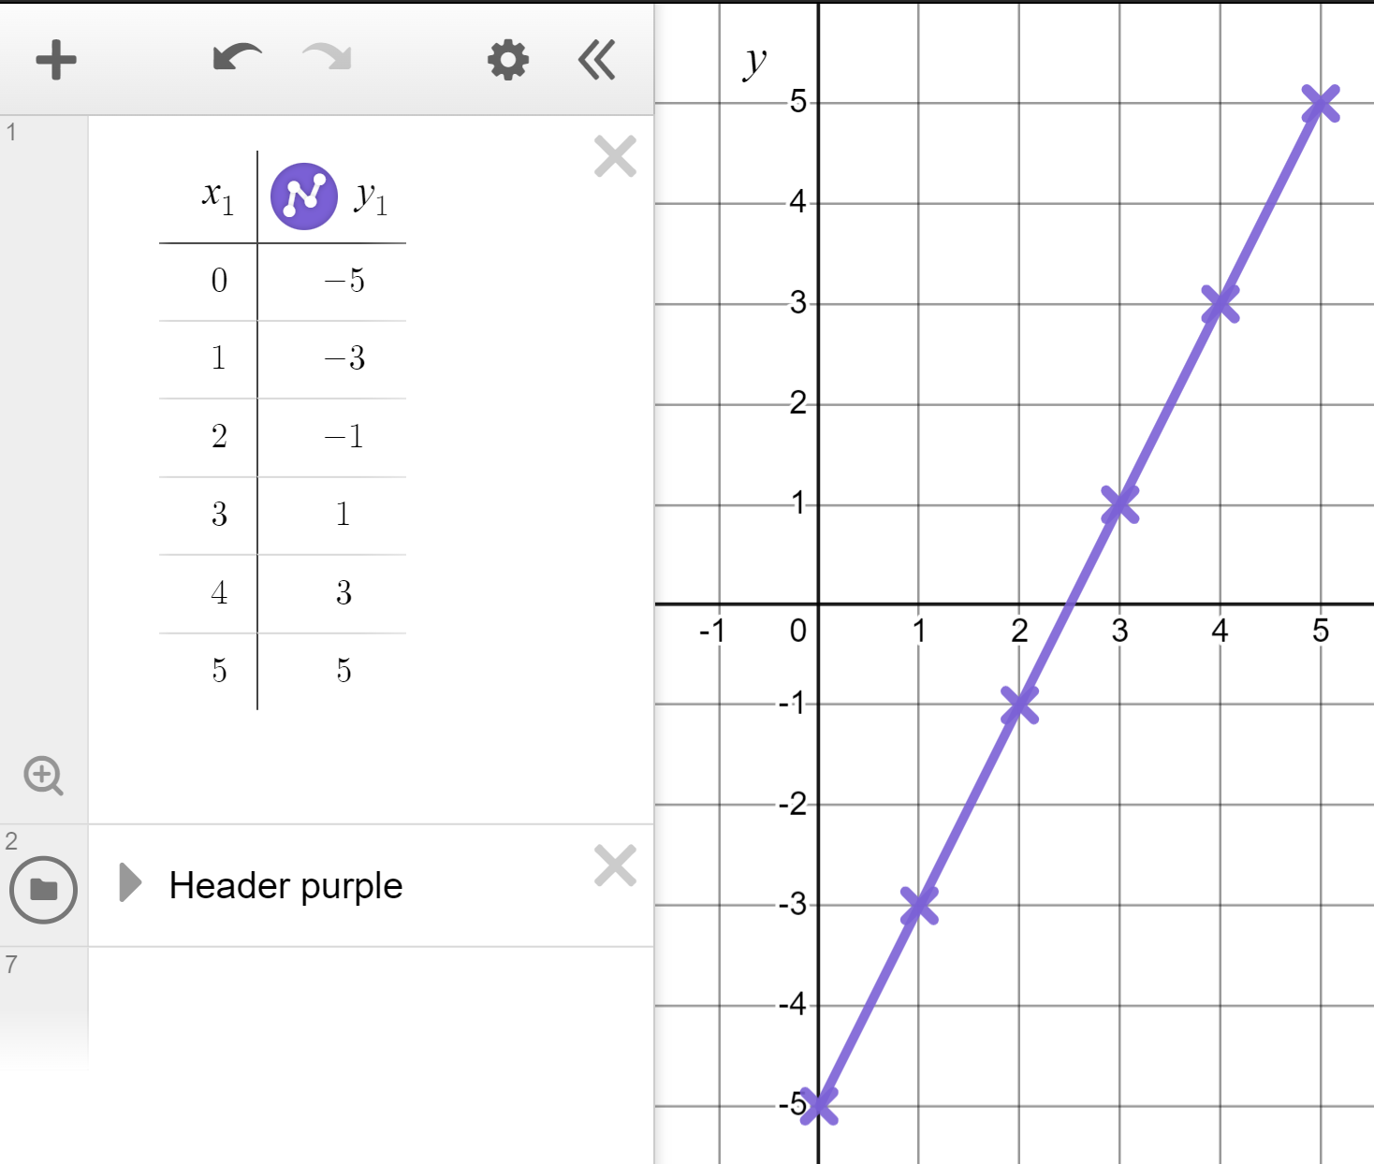
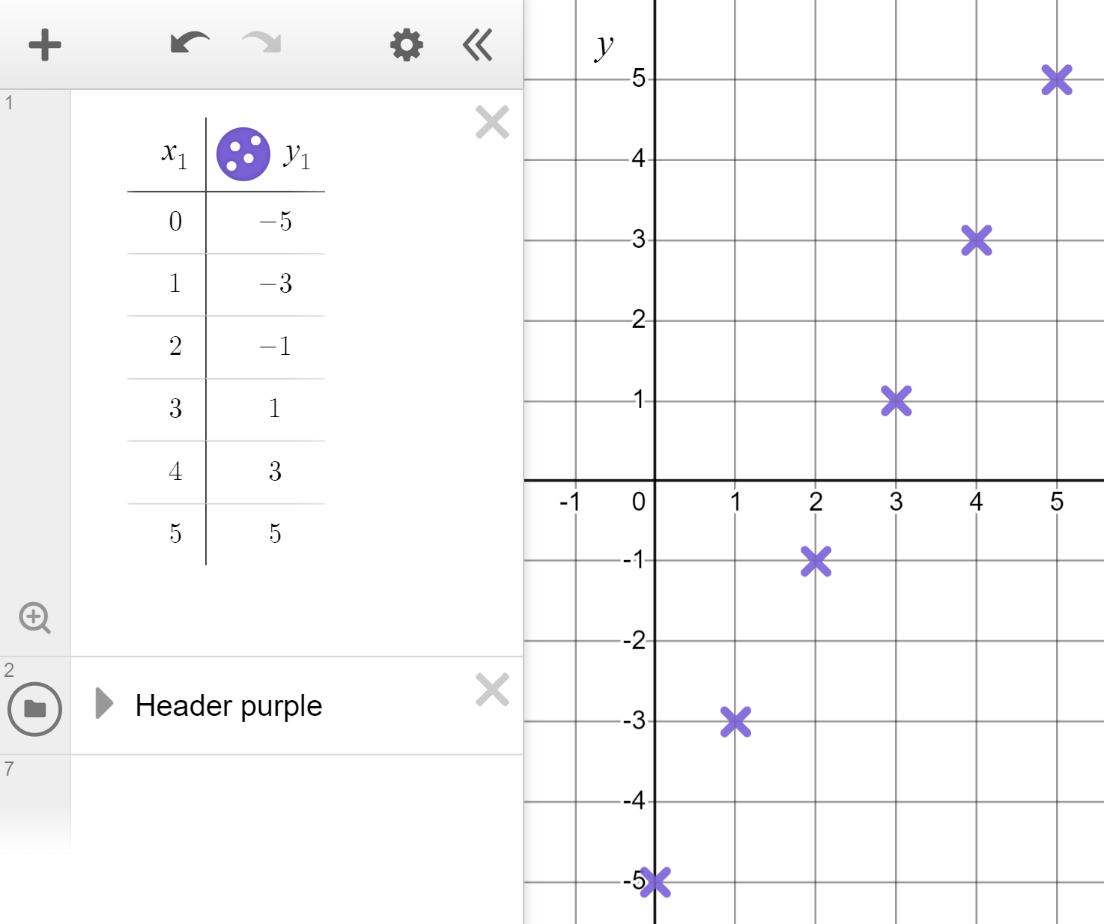

Reviewing plotting graphs of equations
Plot the linear graph of y = 2x − 5 for x-values in the range 0 to +5
Click and hold here to change dots to crosses.
Note that the coordinates form a line. Click and hold here to turn ‘lines’ on.
The linear graph of y = 2x − 5 for the given range 0 ≤ x ≤ 5

Slide 14
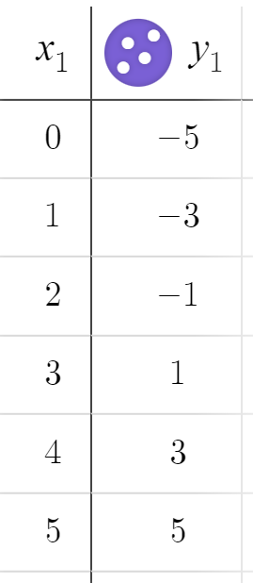
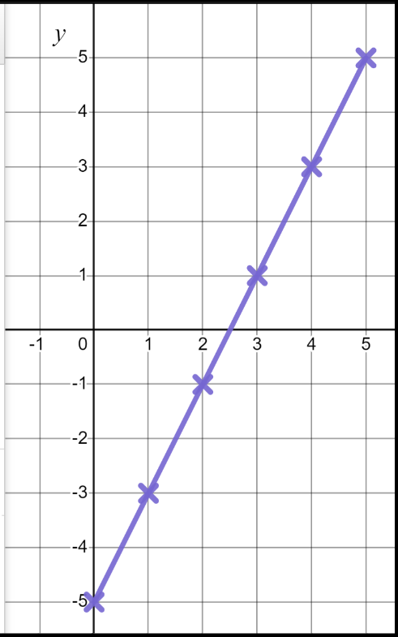
Reviewing plotting graphs of equations
Plot the linear graph of y = 2x − 5 for x-values in the range 0 to +5
Plot the linear graph of y = 2x − 5 for x-values in the range 0 to +5
What do you notice?
+2
A common, constant difference. Hence, a linear graph.
+2
+2
+2
+2
The linear graph of y = 2x − 5 for the given range 0 ≤ x ≤ 5
The linear graph of y = 2x − 5 for the given range 0 ≤ x ≤ 5

Slide 15
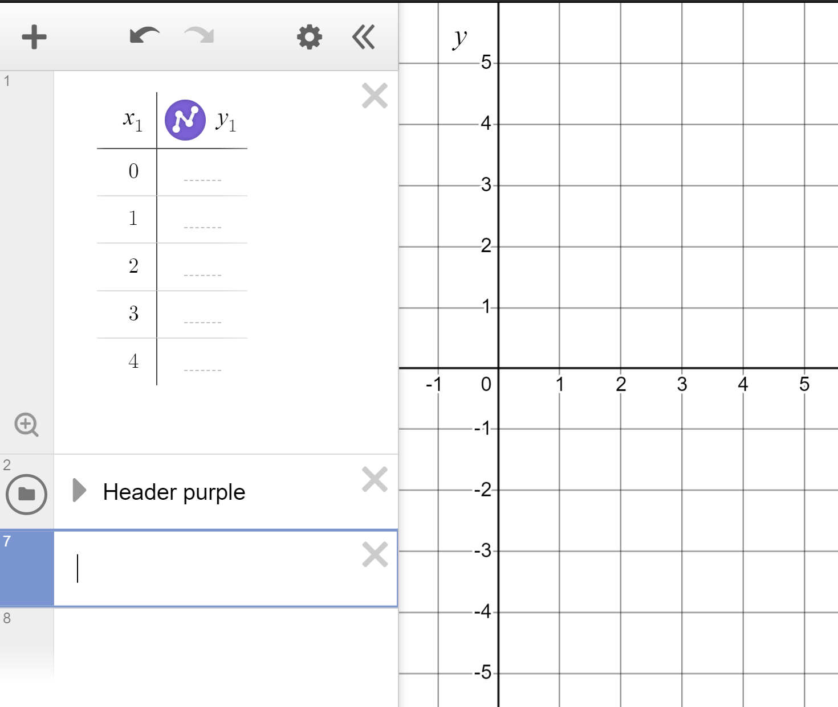
Reviewing plotting graphs of equations
Plot the linear graph of y = 4 − x for x-values in the range 0 to +4
When x = 0, y = 4 − (0) =
When x = 1, y = 4 − (1) =
What shape does the graph make and why?

Slide 16
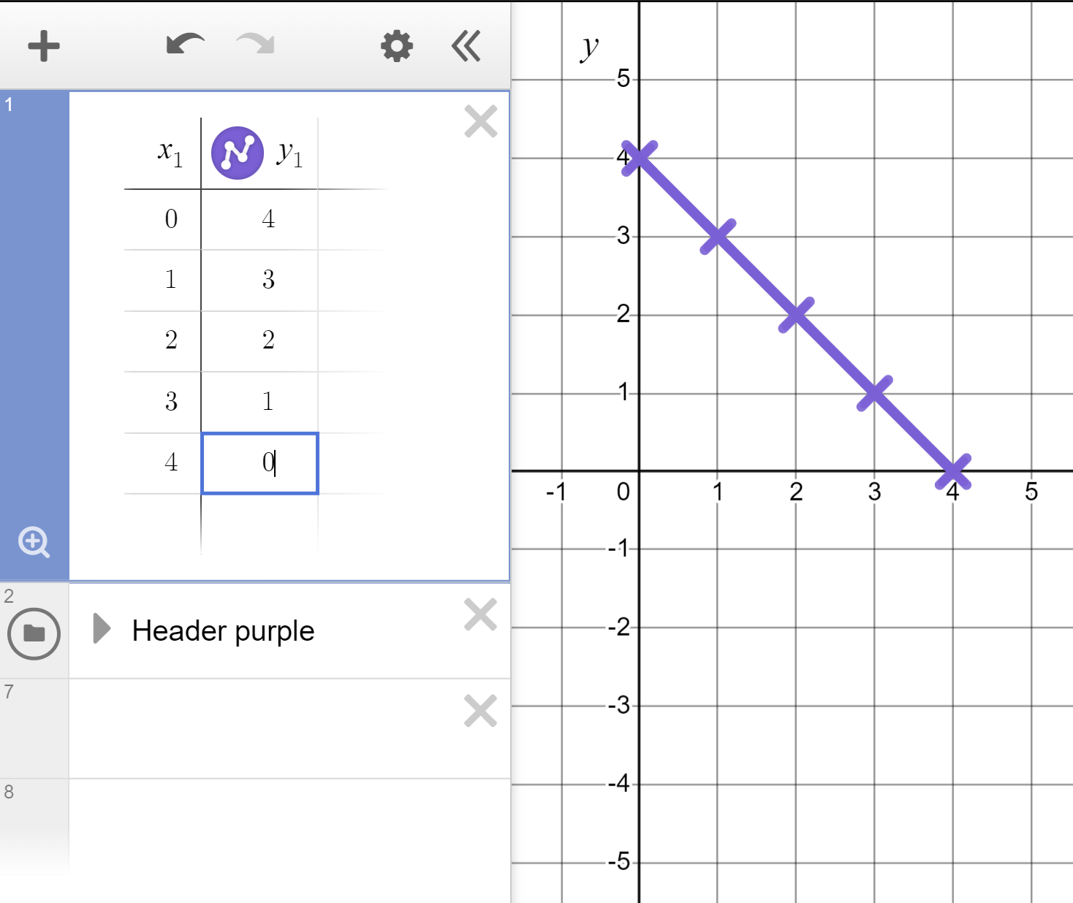
Reviewing plotting graphs of equations
Plot the linear graph of y = 4 − x for x-values in the range 0 to +4
When x = 0, y = 4 − (0) = 4
When x = 1, y = 4 − (1) =
When x = 1, y = 4 − (1) = 3
The linear graph of y = 4 − x for the given range 0 ≤ x ≤ 4
What shape does the graph make and why?
A straight line because of the constant, common difference.

Slide 17
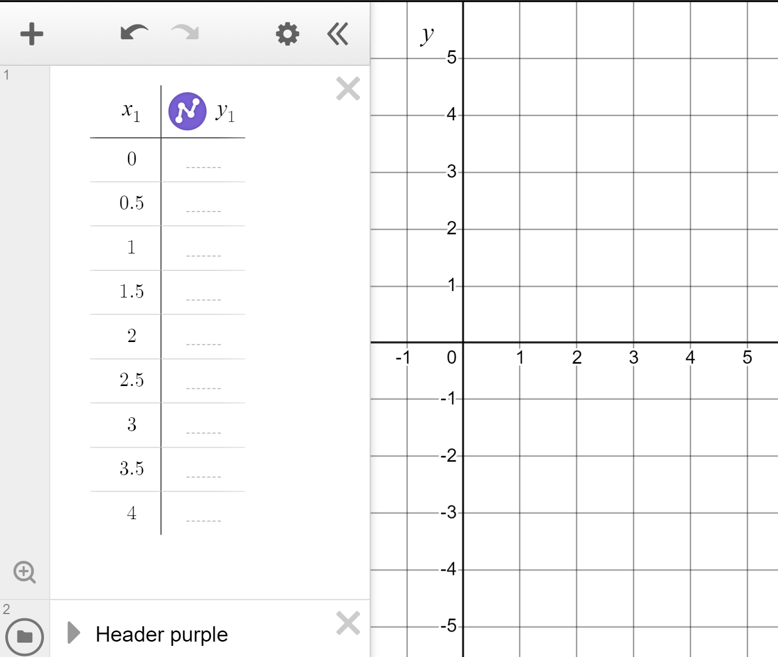
Reviewing plotting graphs of equations
The technology means we don’t have to work out the coordinates ourselves.
Plot the linear graph of y = 3x − 4 for x-values in the range 0 to +4 in steps of 0.5
We really don’t want to have to work out all of those y coordinates!
Type x and 3x − 4 in the table headers.

Slide 18
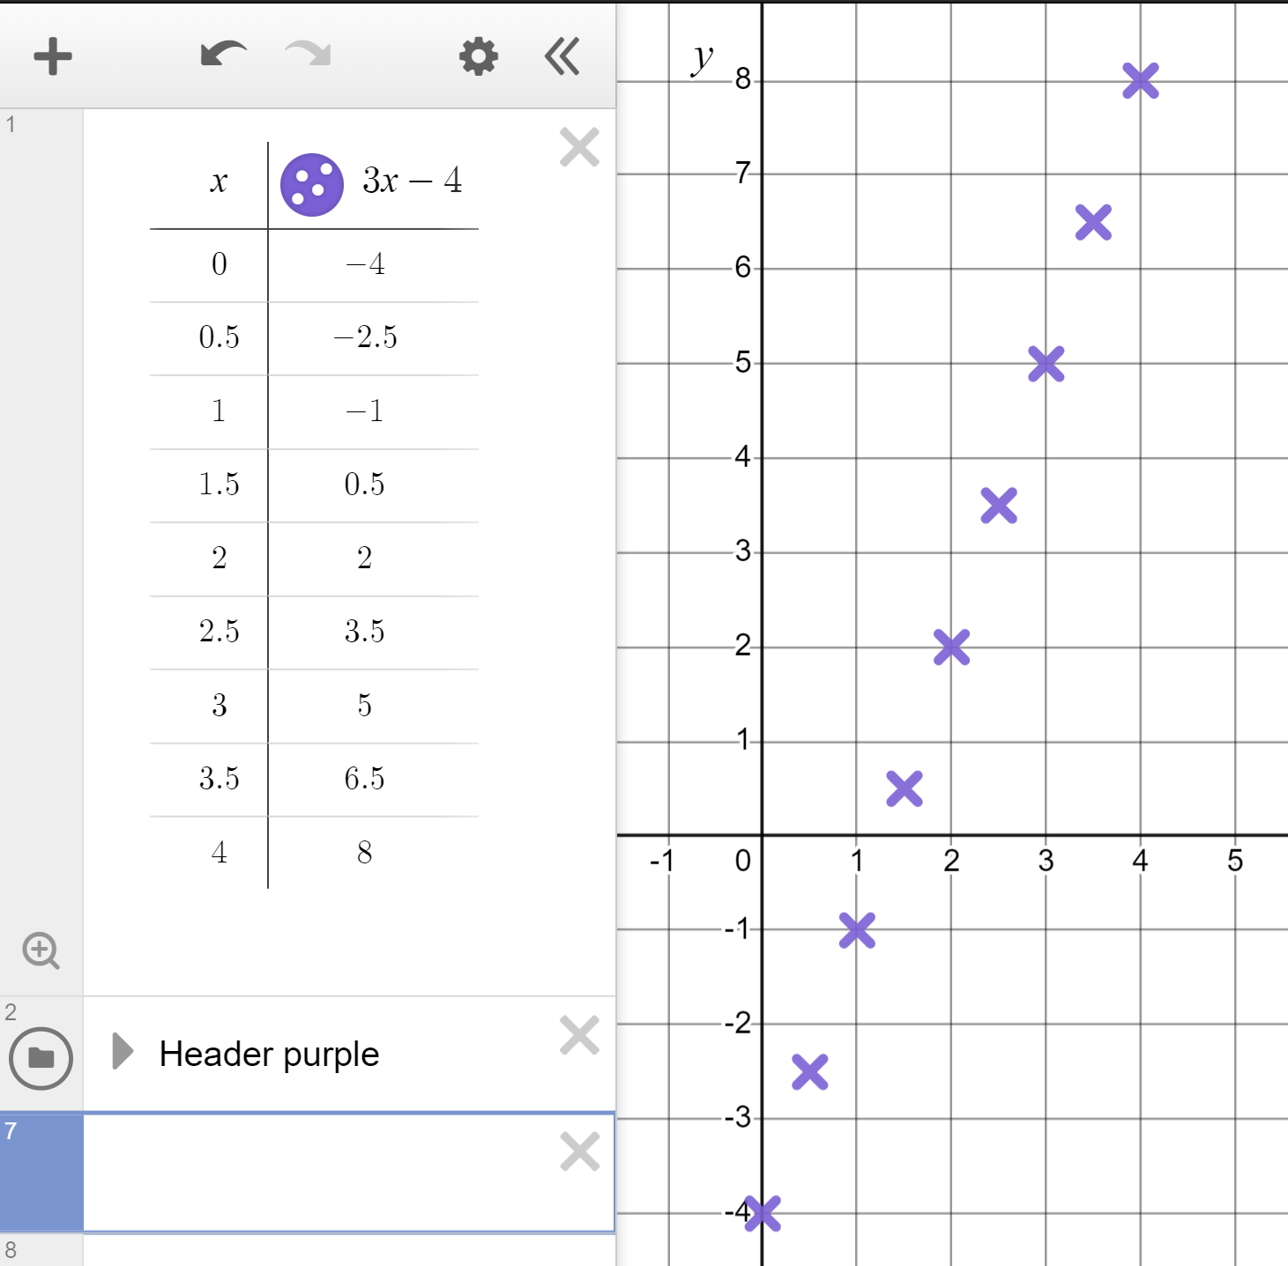
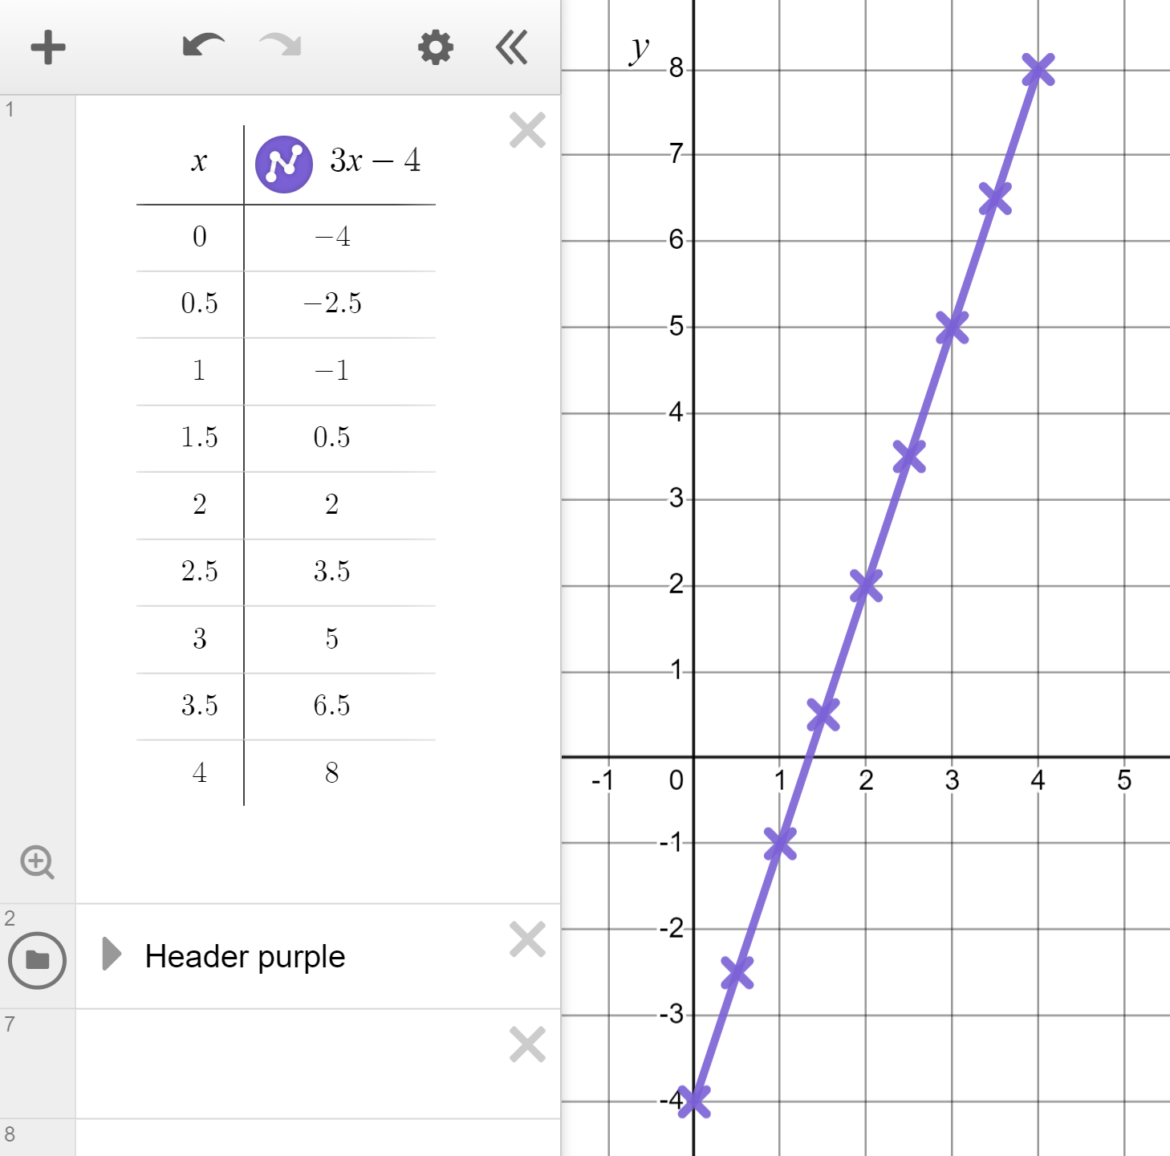
Reviewing plotting graphs of equations
The technology means we don’t have to work out the coordinates ourselves.
Plot the linear graph of y = 3x − 4 for x-values in the range 0 to +4 in steps of 0.5
We really don’t want to have to work out all of those y coordinates!
Type x and 3x − 4 in the table headers.

Slide 19
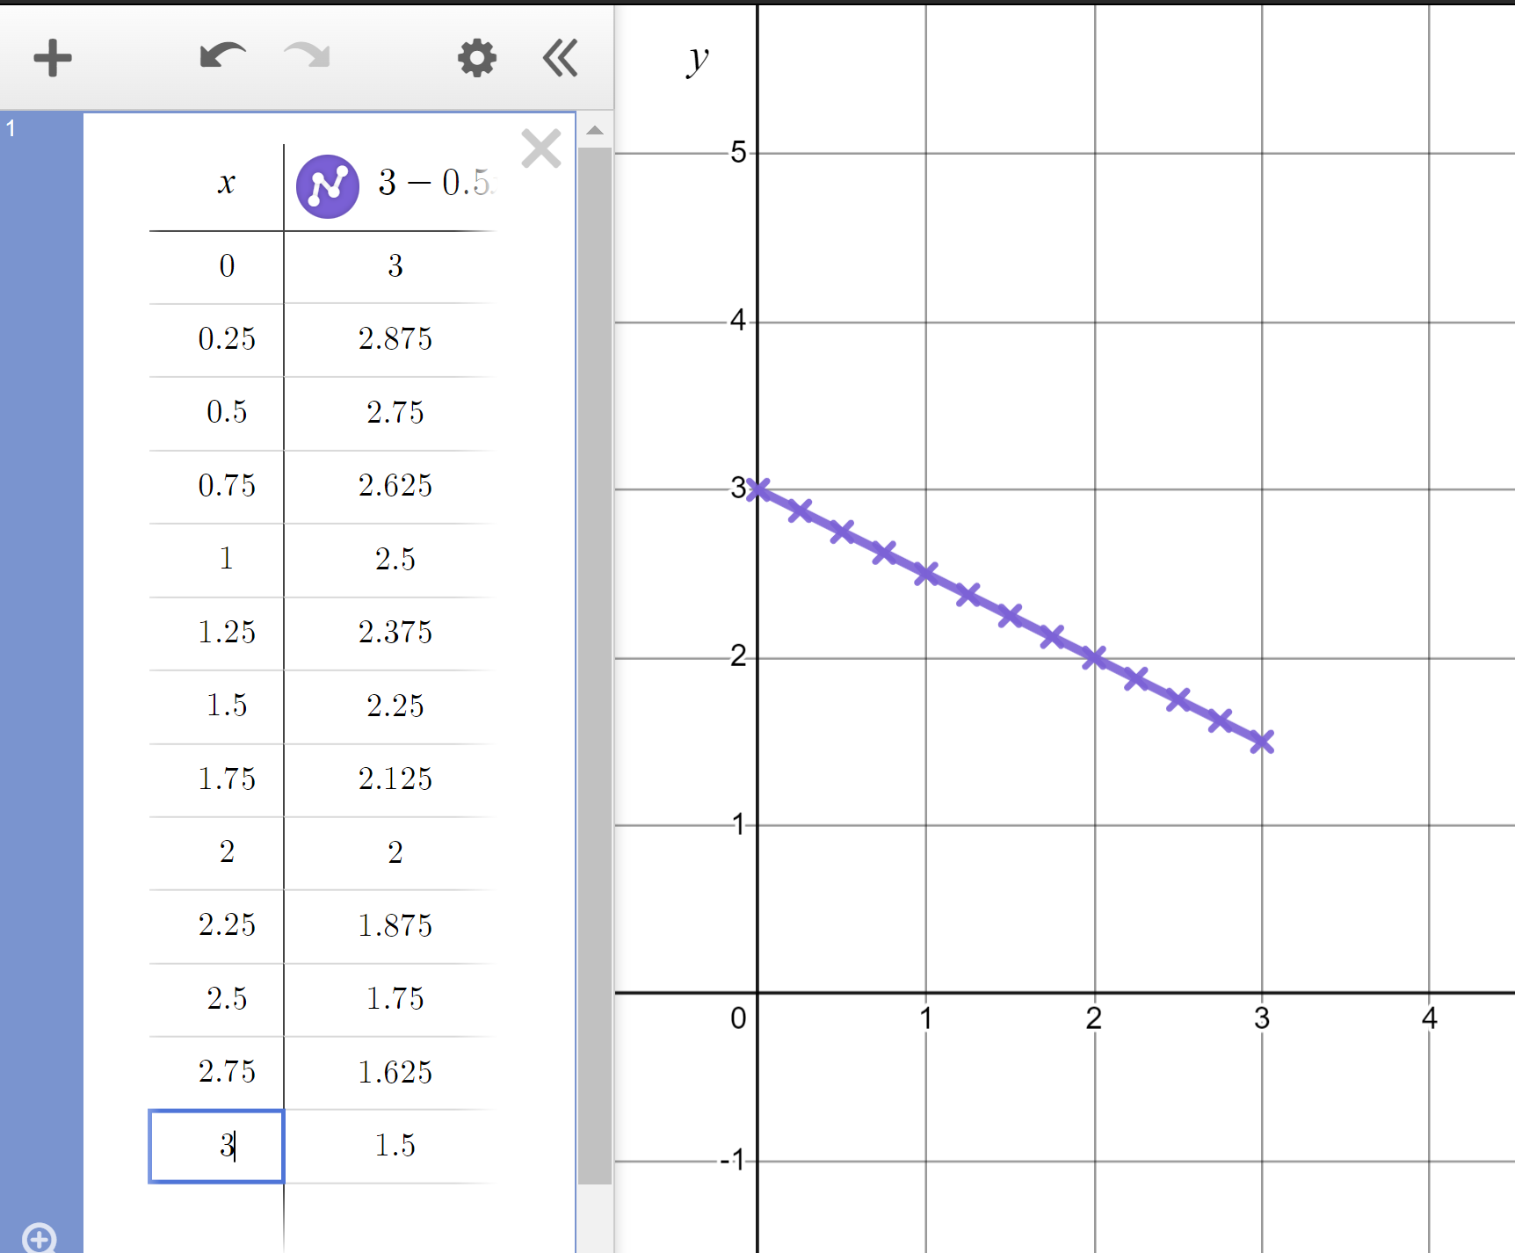
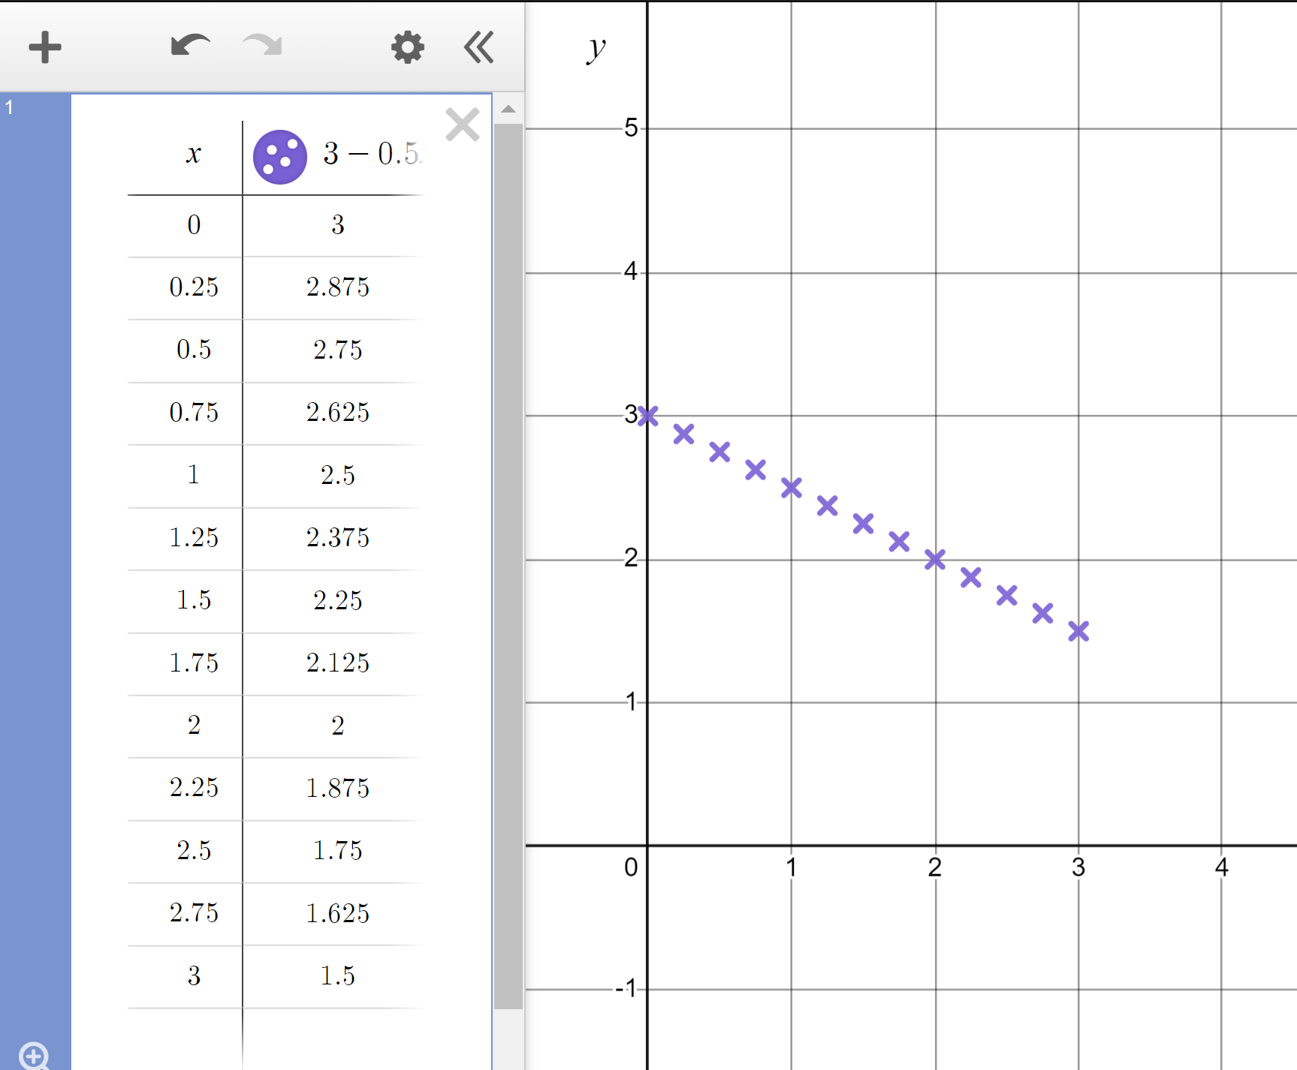
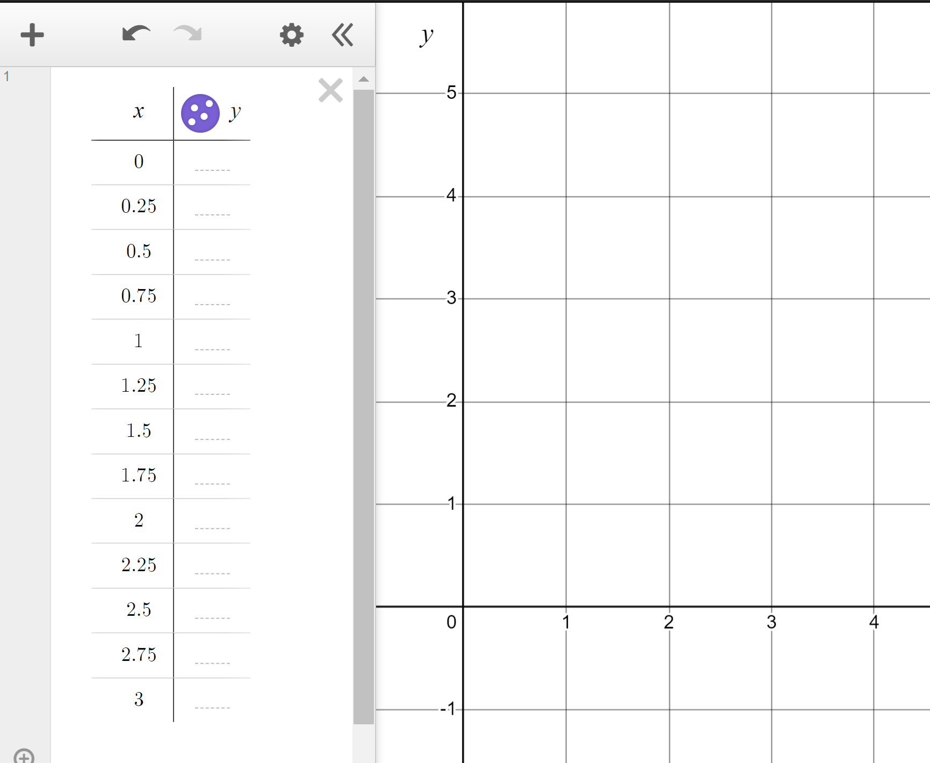
Reviewing plotting graphs of equations
Plot the linear graph of y = 3 − 0.5x for x-values in the range 0 to +3 in steps of 0.25
The linear graph of y = 3 − 0.5x for the given range 0 ≤ x ≤ 3

Slide 20
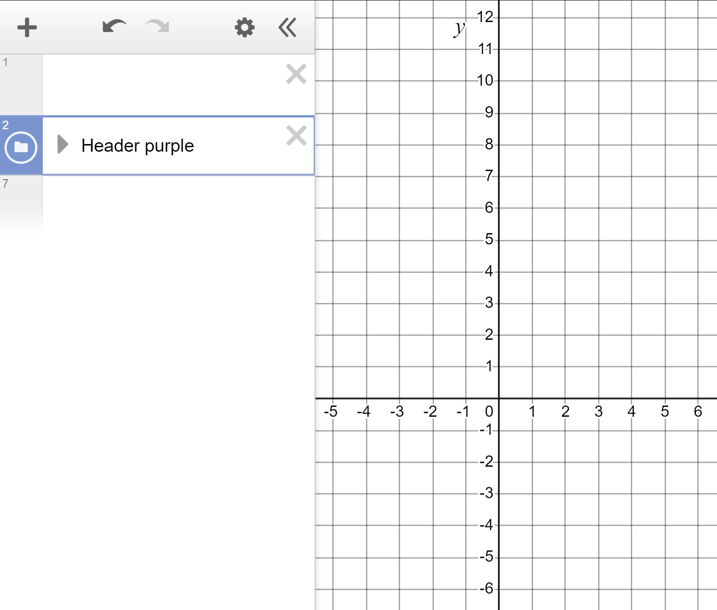
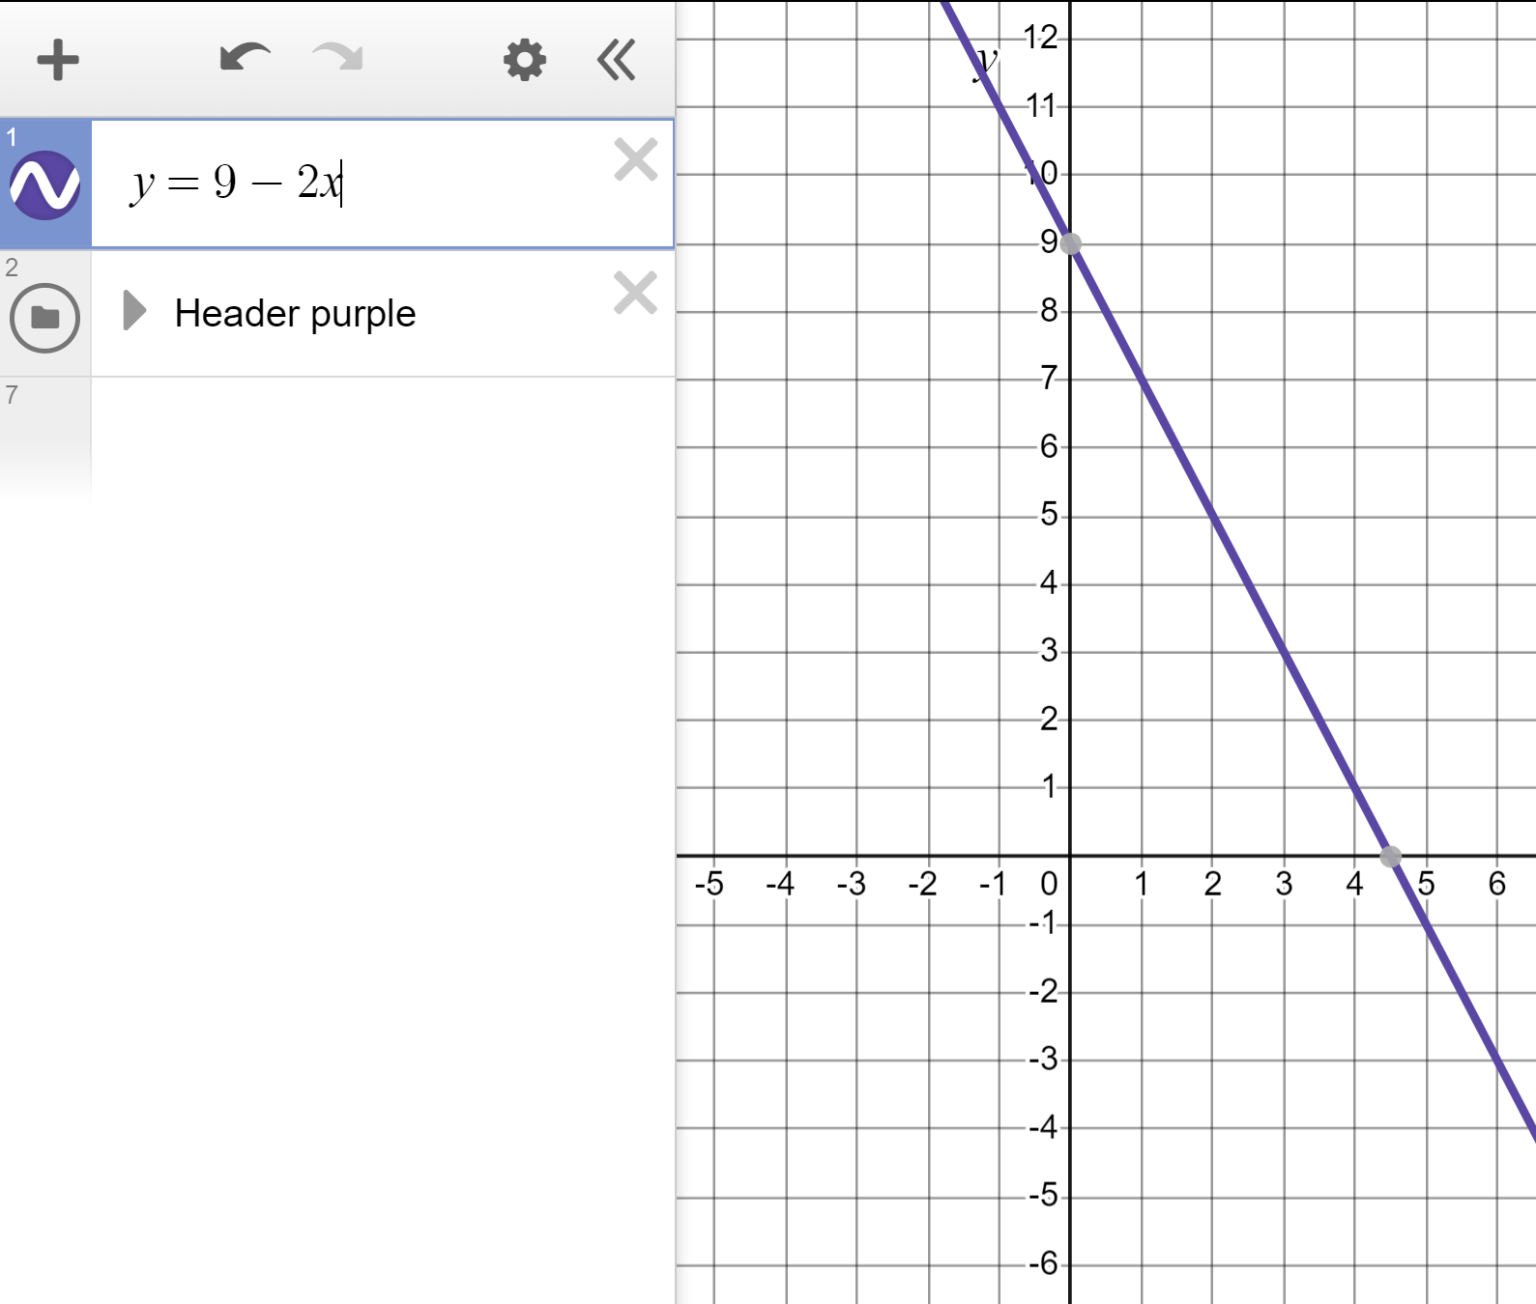
Reviewing plotting graphs of equations
The technology can plot these lines even more quickly for us.
We don’t have to plot the individual coordinates with a table.
Type y = 9 − 2x in here.
The linear graph of y = 9 − 2x with no restriction on range. This is the true nature of this graph; it has no beginning and no end.

Slide 21
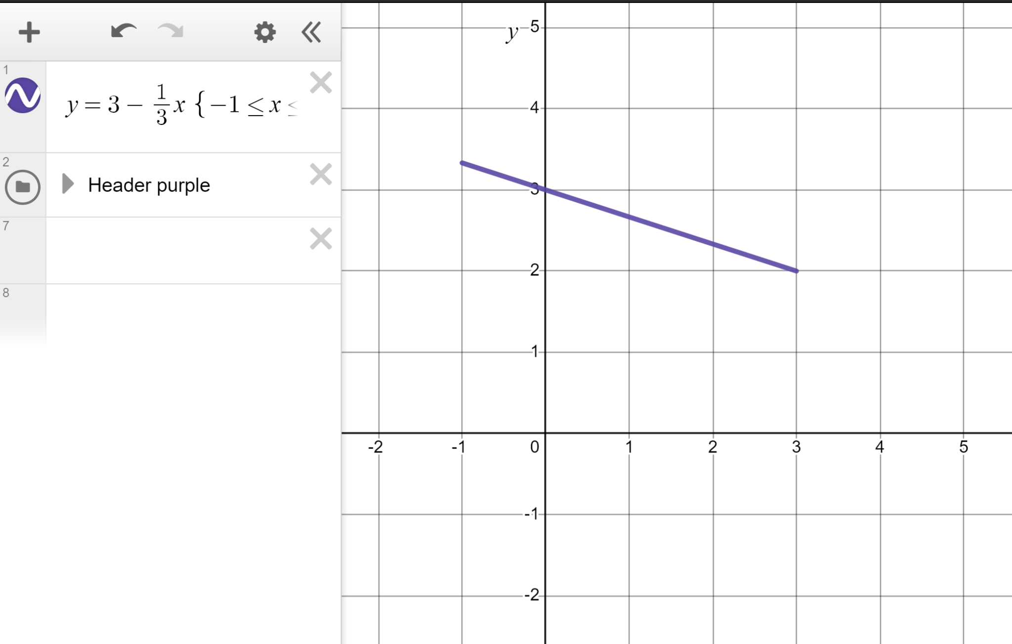
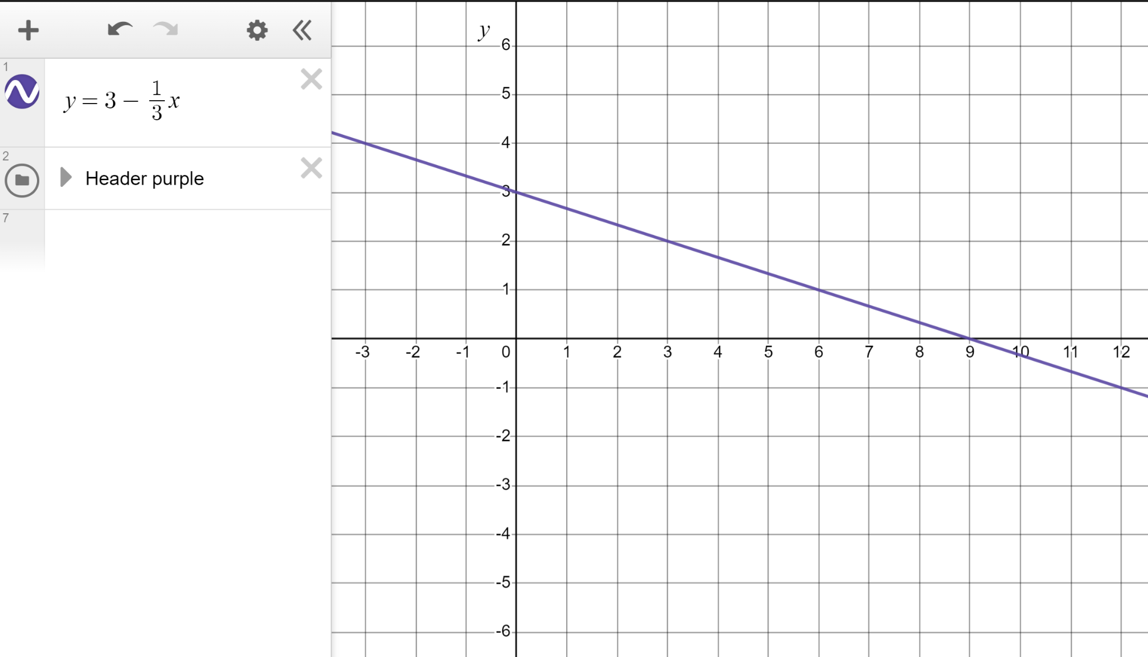
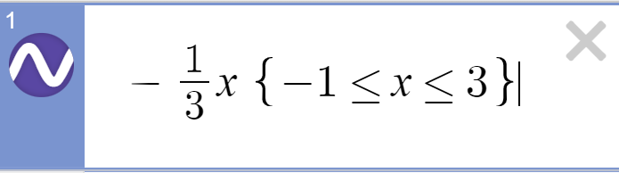
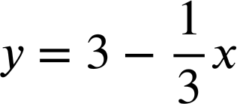
Reviewing plotting graphs of equations
We can limit the range when plotting linear graphs this way.
Typing {−1 ≤ x ≤ 3} immediately after the function will give the range these limits.
The linear graph of
for the given range −1 ≤ x ≤ 3

Slide 22
Reviewing plotting graphs of equations
1) Create a table of values to plot the linear graph of y = 11 − 5x for x-values in the range −2 ≤ x ≤ 3 in steps of 0.5

Slide 23
Reviewing plotting graphs of equations
2)
a) Without using a table plot the linear graph of y = 7 − x
b) Without using a table plot the linear graph of x + y = 5
c) What do you notice about the shape of the two graphs?
Write a sentence.

Slide 24
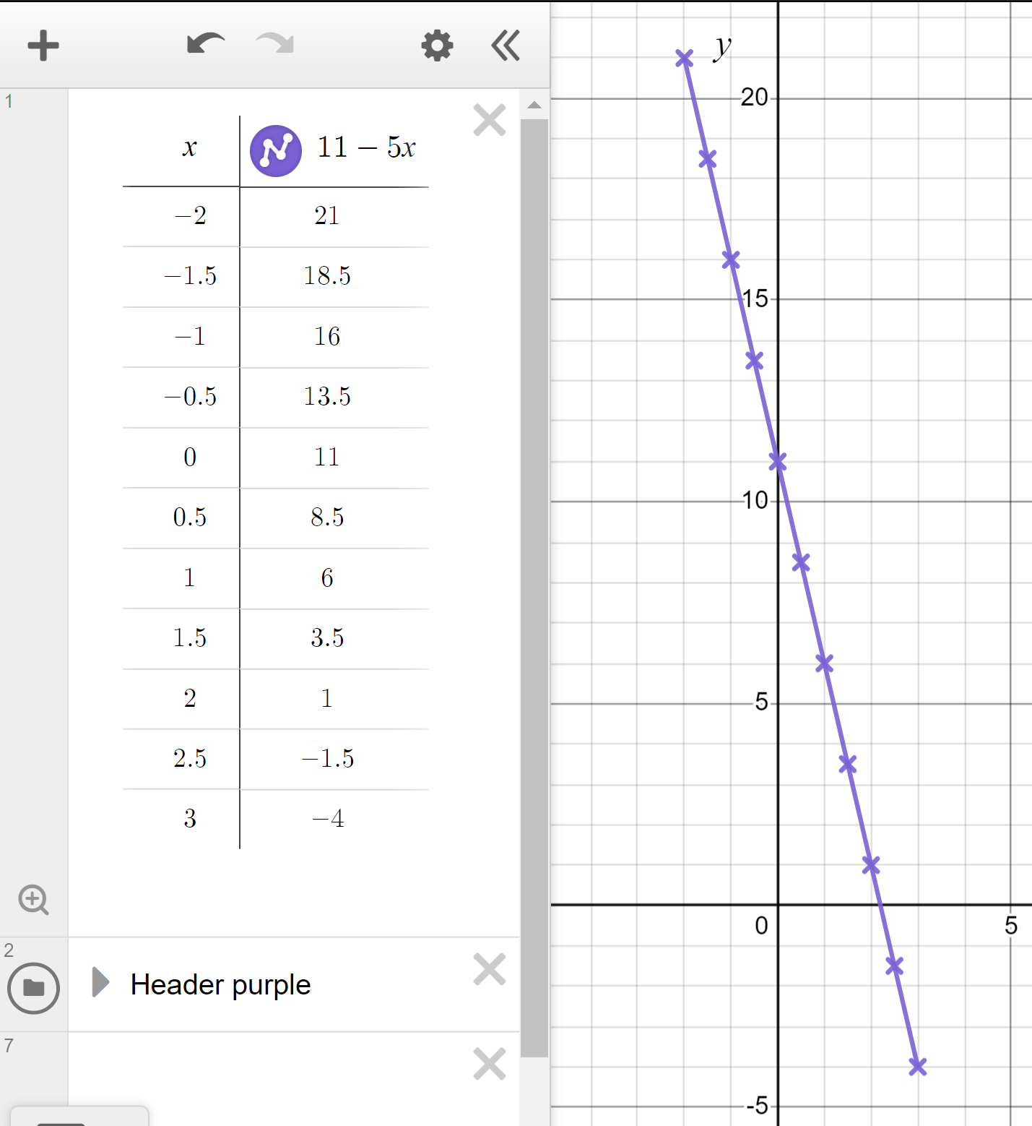
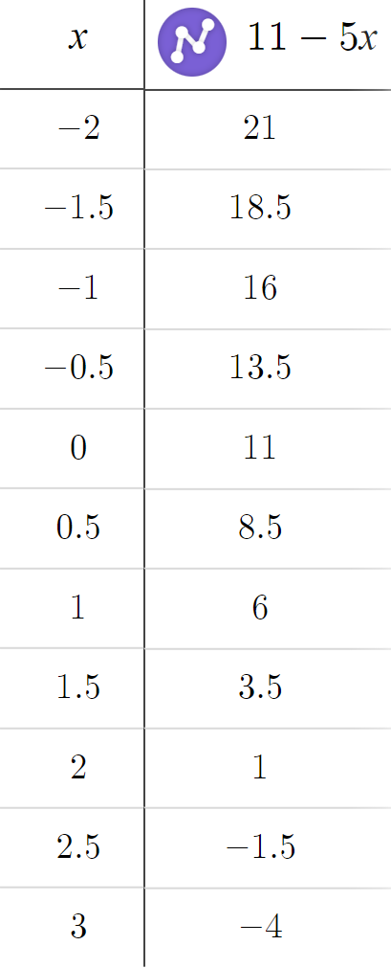
Reviewing plotting graphs of equations
1) Create a table of values to plot the linear graph of y = 11 − 5x for x-values in the range −2 ≤ x ≤ 3 in steps of 0.5

Slide 25
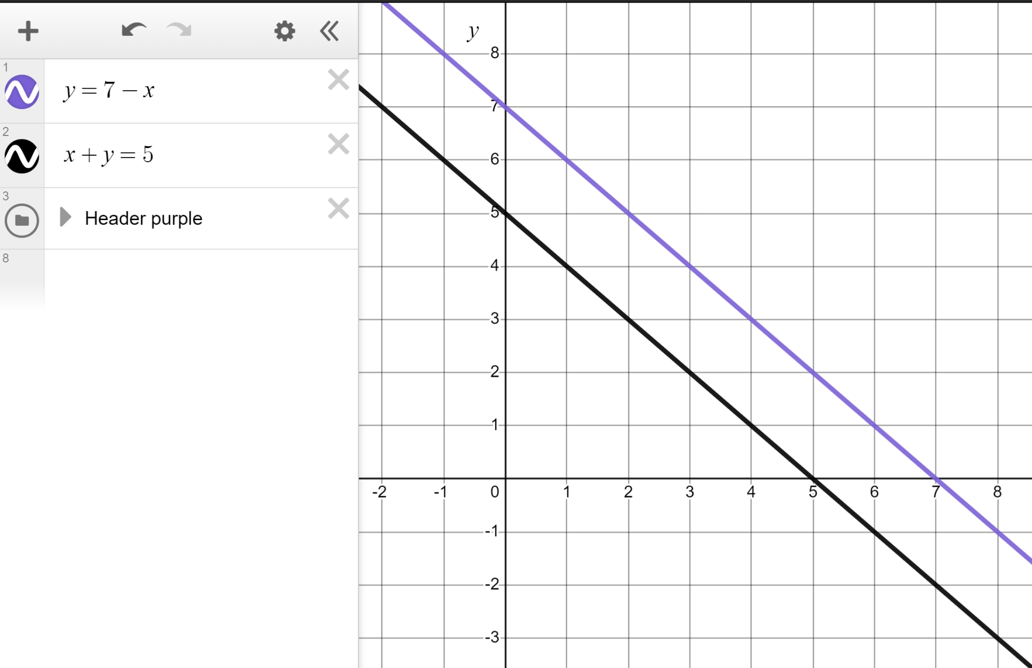
Reviewing plotting graphs of equations
2)
a) Without using a table plot the linear graph of y = 7 − x
b) Without using a table plot the linear graph of x + y = 5
c) What do you notice about the shape of the two graphs?
Write a sentence.

Slide 26
Reviewing plotting graphs of equations
2)
a) Without using a table plot the linear graph of y = 7 − x
b) Without using a table plot the linear graph of x + y = 5
x + y − x = 5 − x
y = 5 − x
You might have written:
Both are linear graphs. Both have a gradient of −1 making them parallel.
It is the x exponent of 1 that makes them both linear equations.

Slide 27
Exploring the shapes of graphs using technology
Reviewing plotting graphs of equations
Plotting quadratic graphs

Slide 28
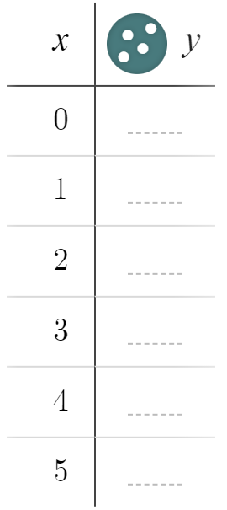
Plotting quadratic graphs
There are many different types of equations and certain types of equations make graphs of certain shapes.
Make a table of values for the equation y = x² for x-values in the range 0 ≤ x ≤ 5
When x = 0, y = (0)² = 0
When x = 1, y = (1)² = 1

Slide 29
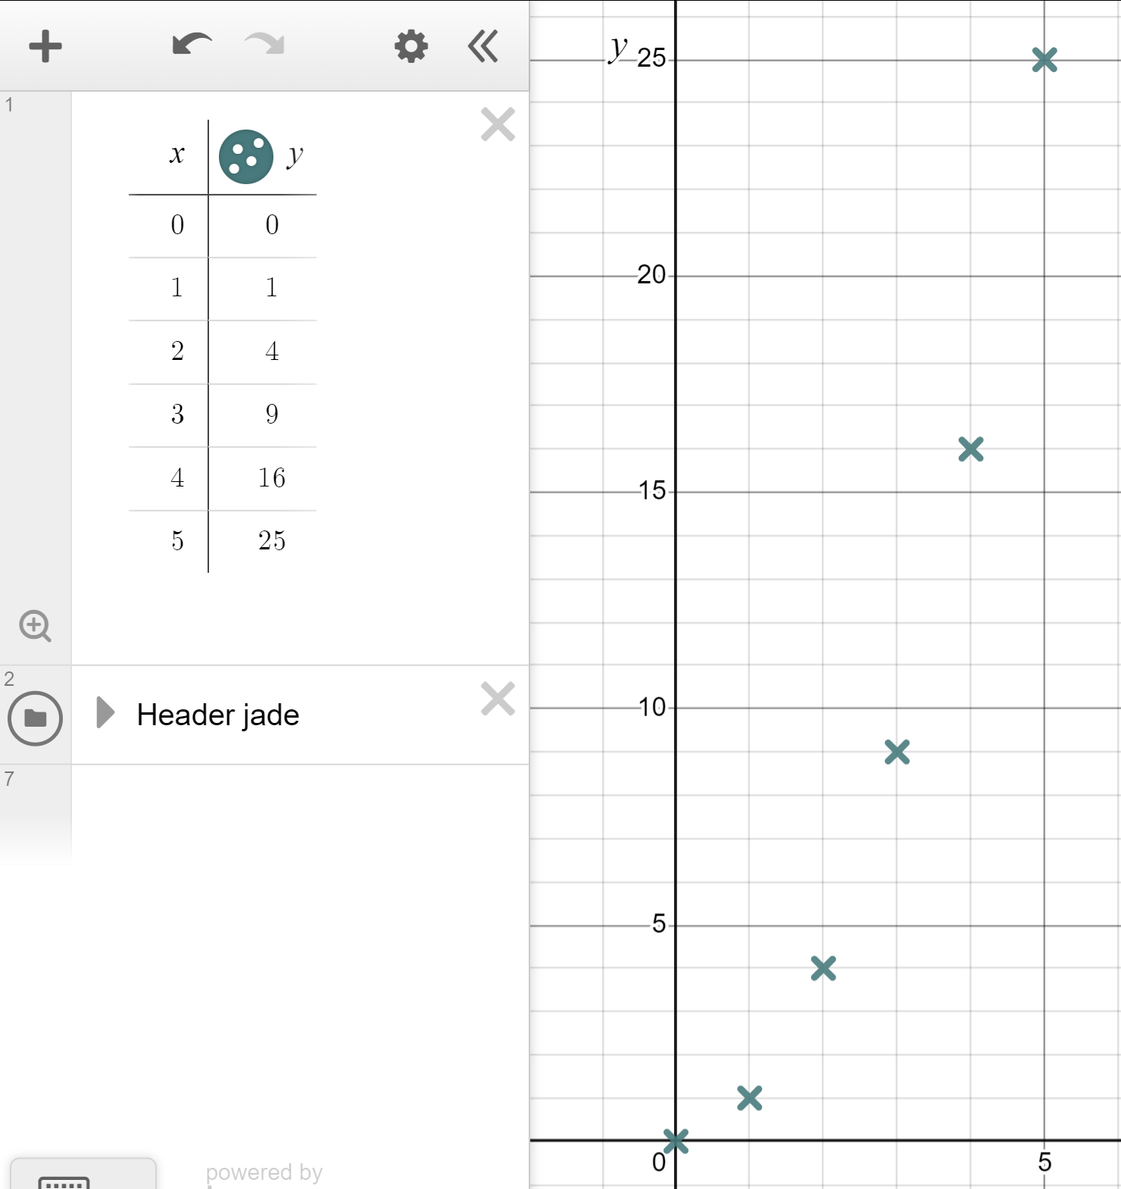
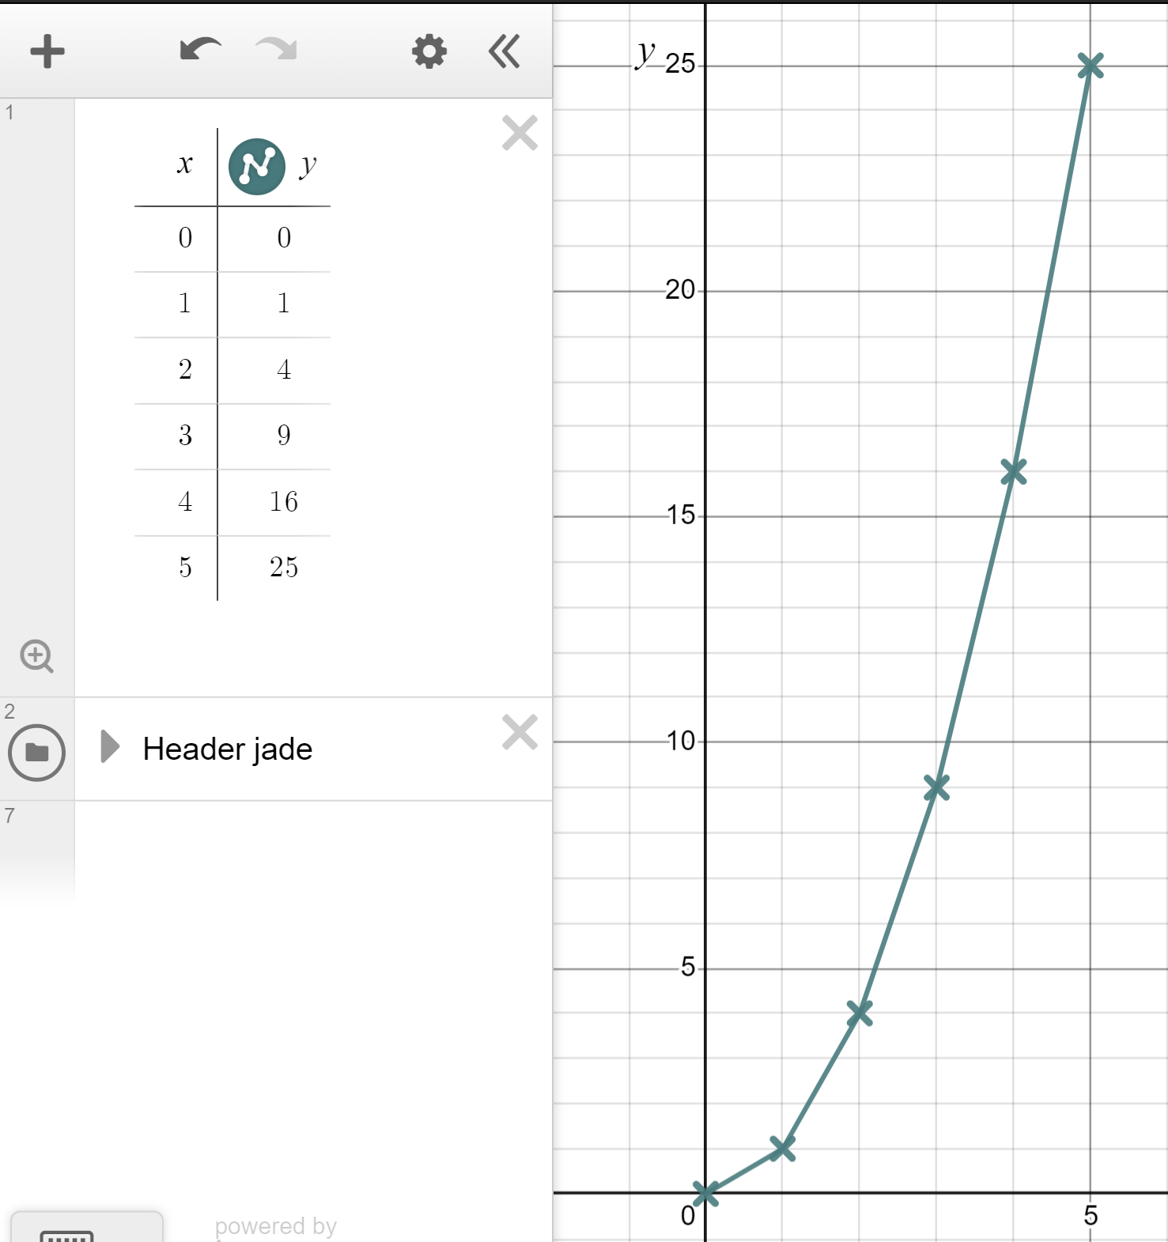
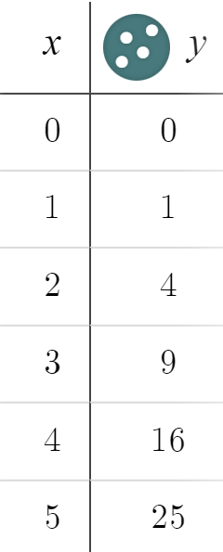
Plotting quadratic graphs
Make a table of values for the equation y = x² for x-values in the range 0 ≤ x ≤ 5
These points are not in a straight line. This is a non-linear graph.
So do we connect these points with straight lines?

Slide 30
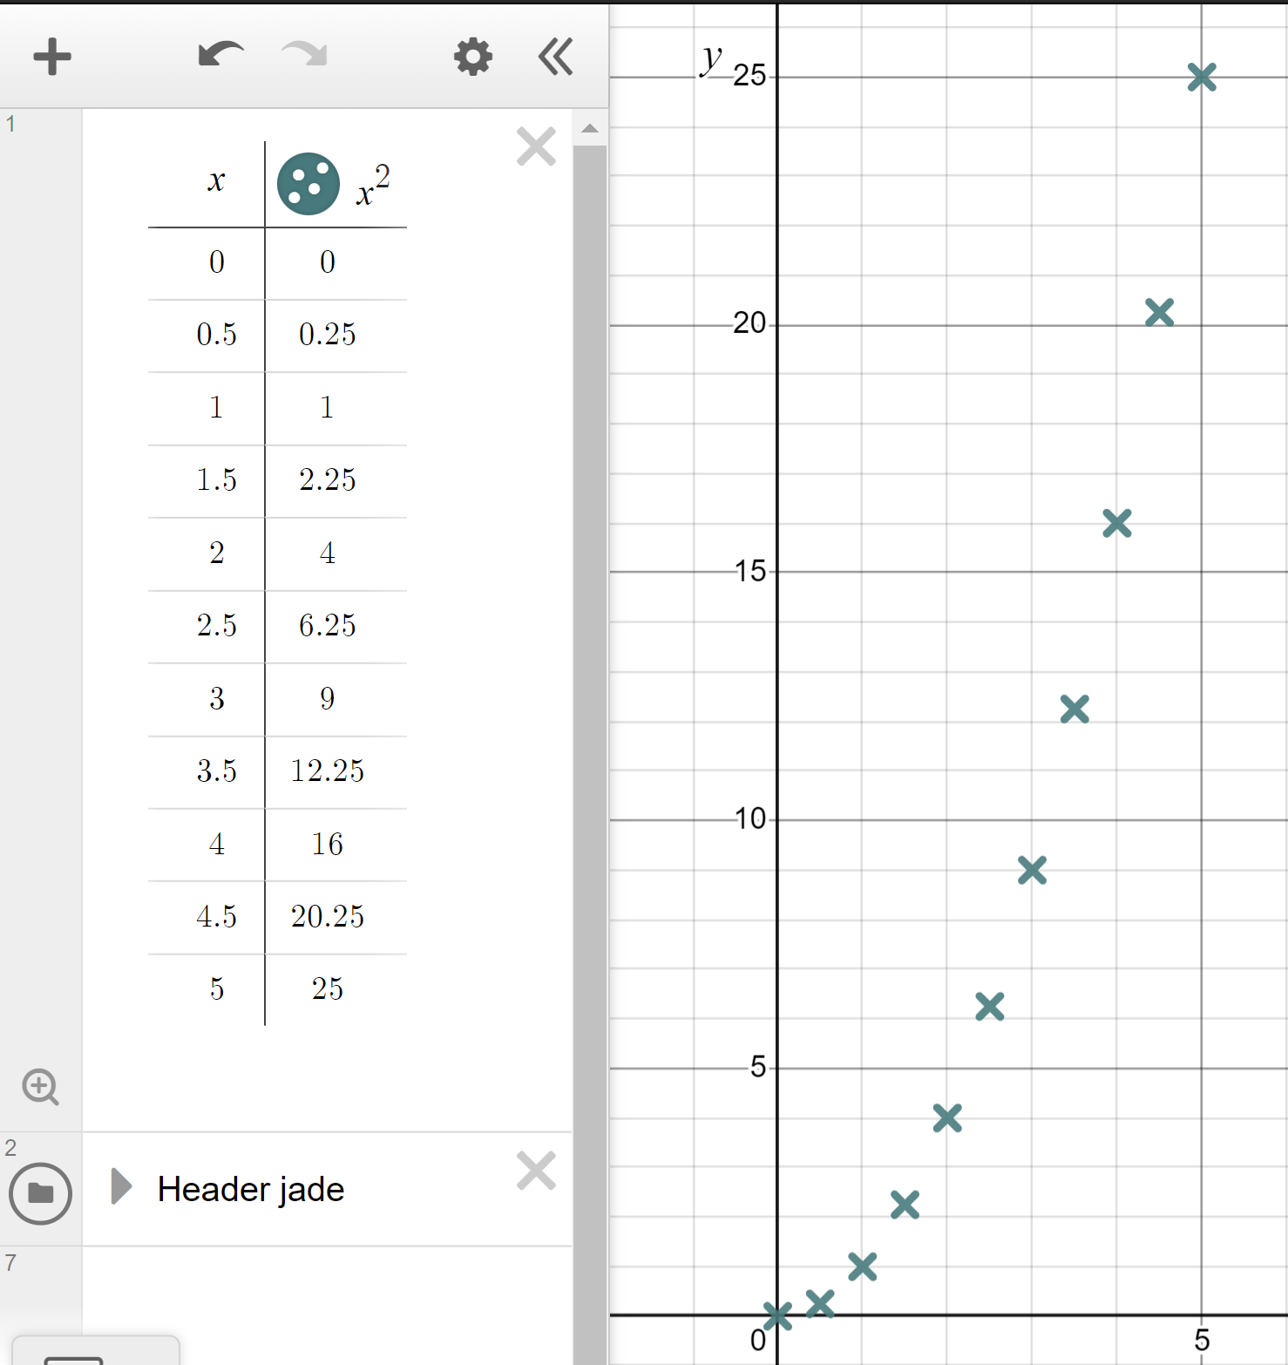
Plotting quadratic graphs
x and x² typed in as column headers.
Make a table of values for the equation y = x² for x-values in the range 0 ≤ x ≤ 5
We can take shorter steps in our table to understand the shape of this function.
Steps of 0.5 start to show the graph’s true shape.

Slide 31
Plotting quadratic graphs
x and x² typed in as column headers.
Make a table of values for the equation y = x² for x-values in the range 0 ≤ x ≤ 5
Use steps of 0.25 to show more clearly the graph’s true shape.

Slide 32
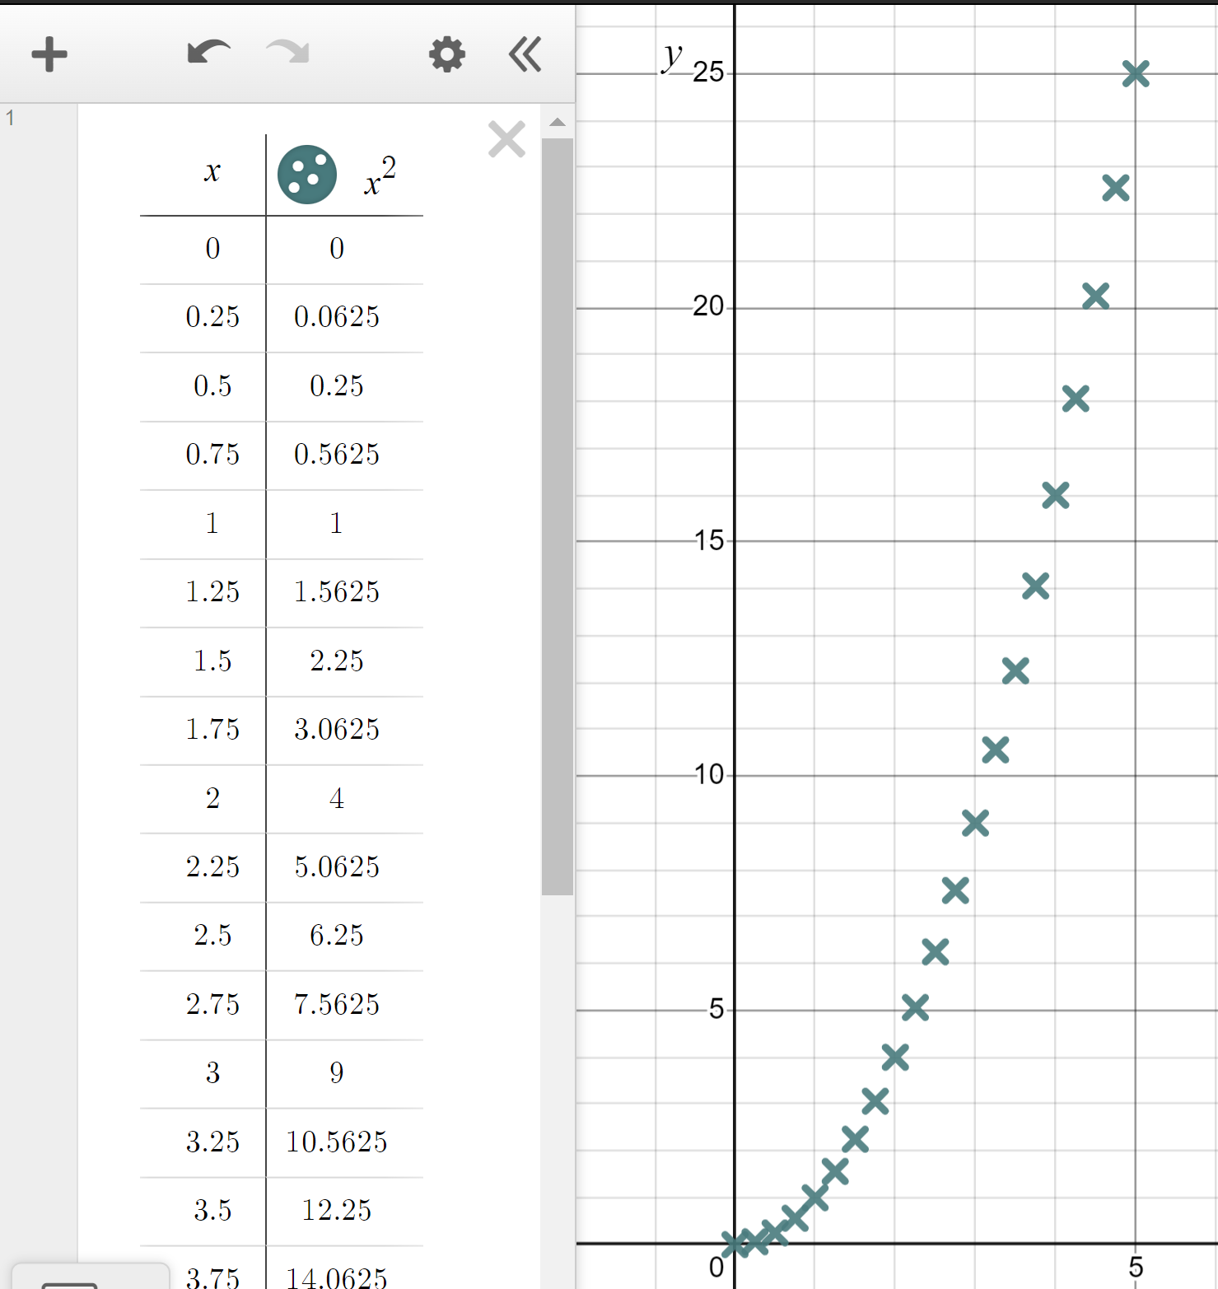
Plotting quadratic graphs
Make a table of values for the equation y = x² for x-values in the range 0 ≤ x ≤ 5
Steps of 0.25 show that the graph of y = x² makes an upward curve of increasing gradient.

Slide 33
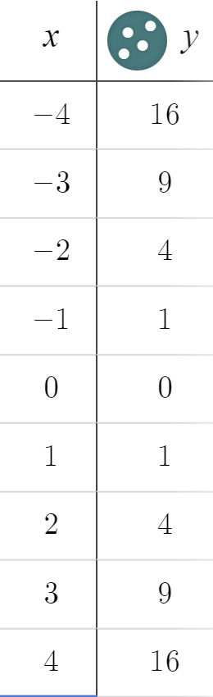
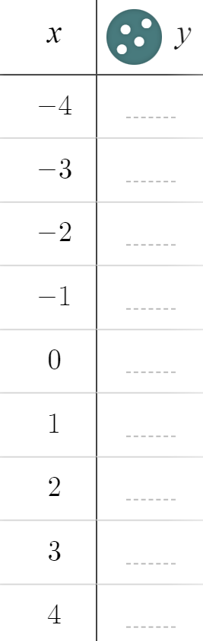
Plotting quadratic graphs
Just like our linear graphs we can input negative values of x too.
Make a table of values for the equation y = x² for x-values in the range −4 ≤ x ≤ 4
When x = −4, y = (−4)² =
When x = −4, y = (−4)² = 16
When x = −3, y = (−3)² =
When x = −3, y = (−3)² = 9

Slide 34

Plotting quadratic graphs
Just like our linear graphs we can input negative values of x too.
Make a table of values for the equation y = x² for x-values in the range −4 ≤ x ≤ 4
What do you notice?
Symmetry in the y-values.
Because...
(−1)² = (1)²
(−2)² = (2)²

Slide 35
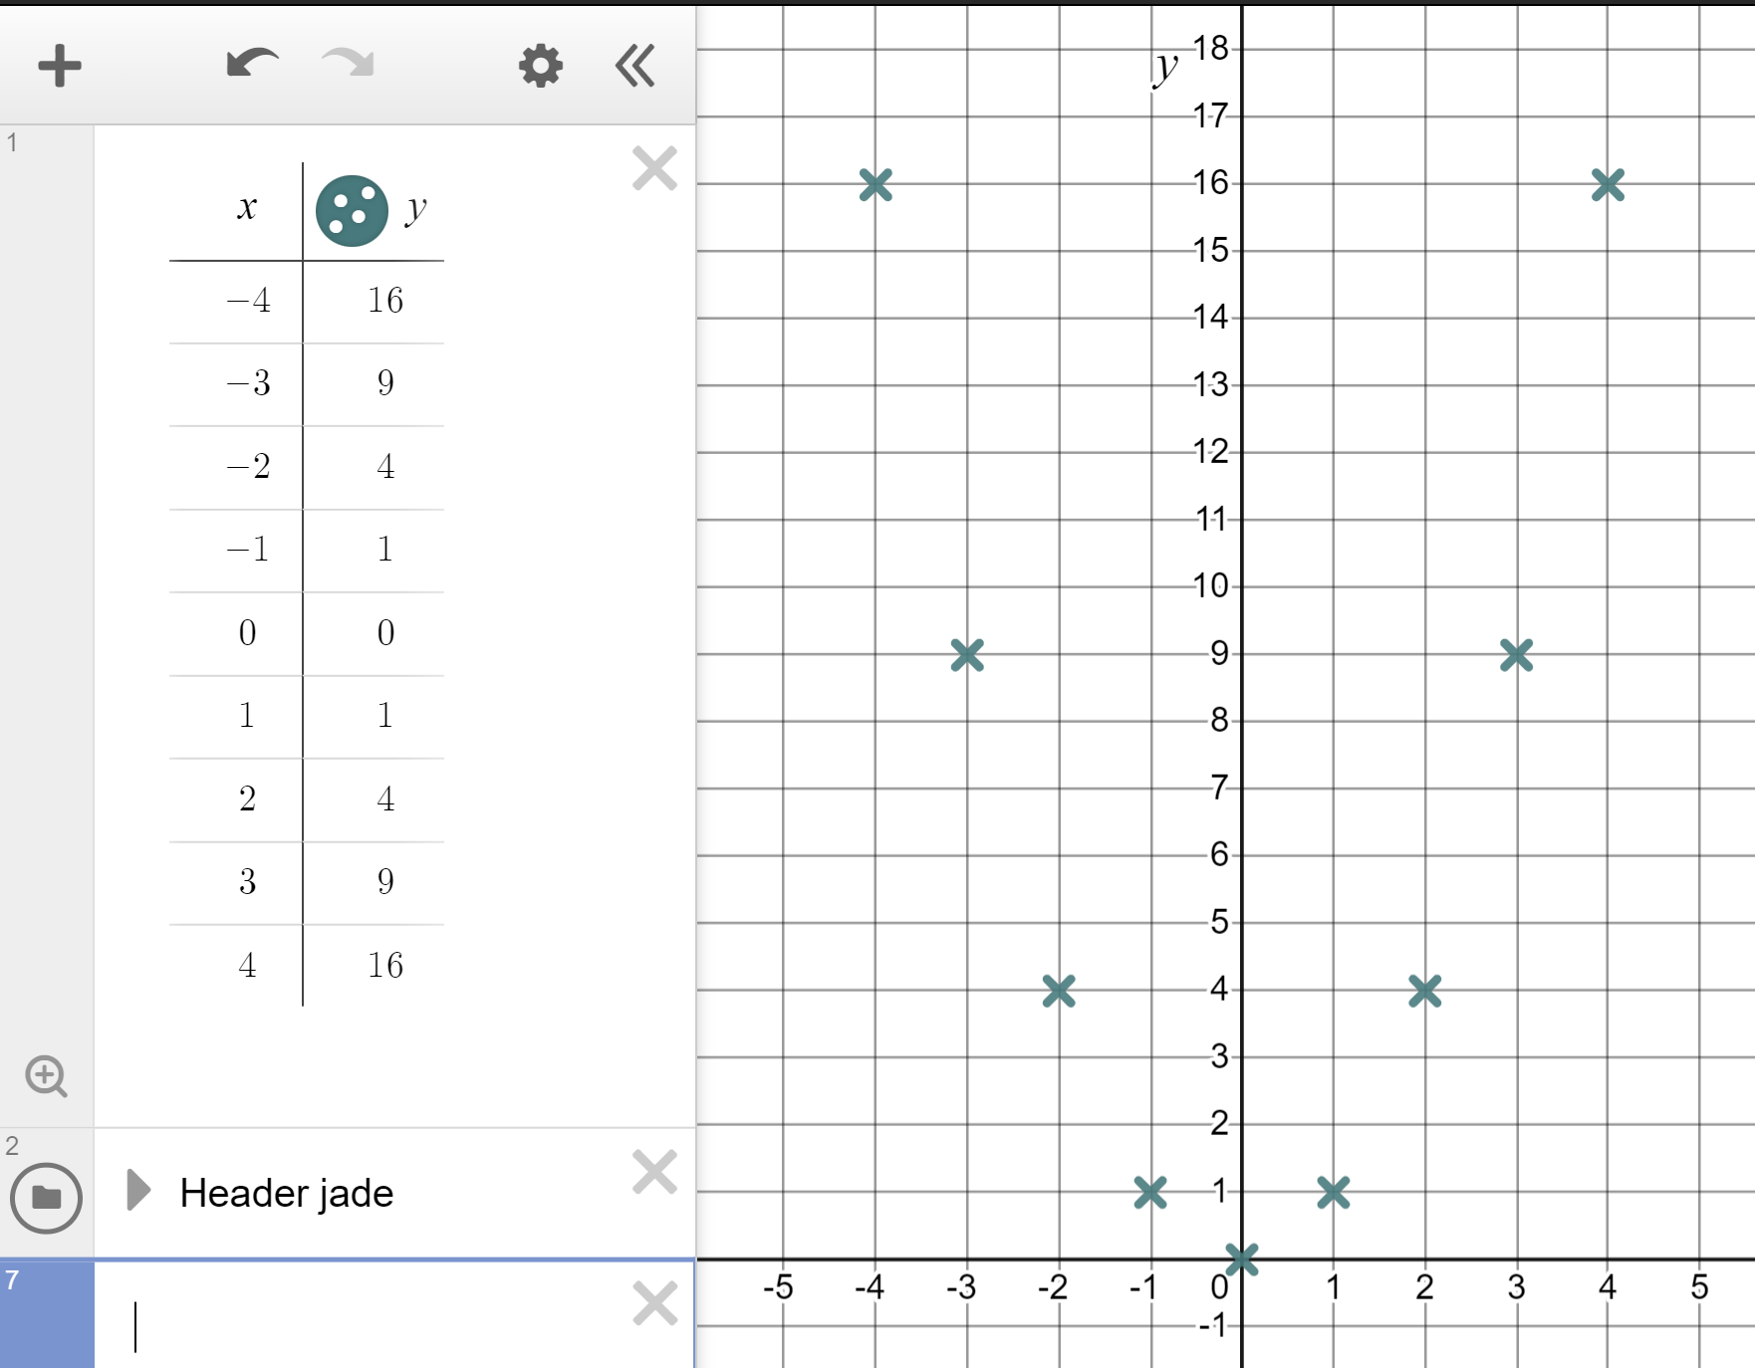
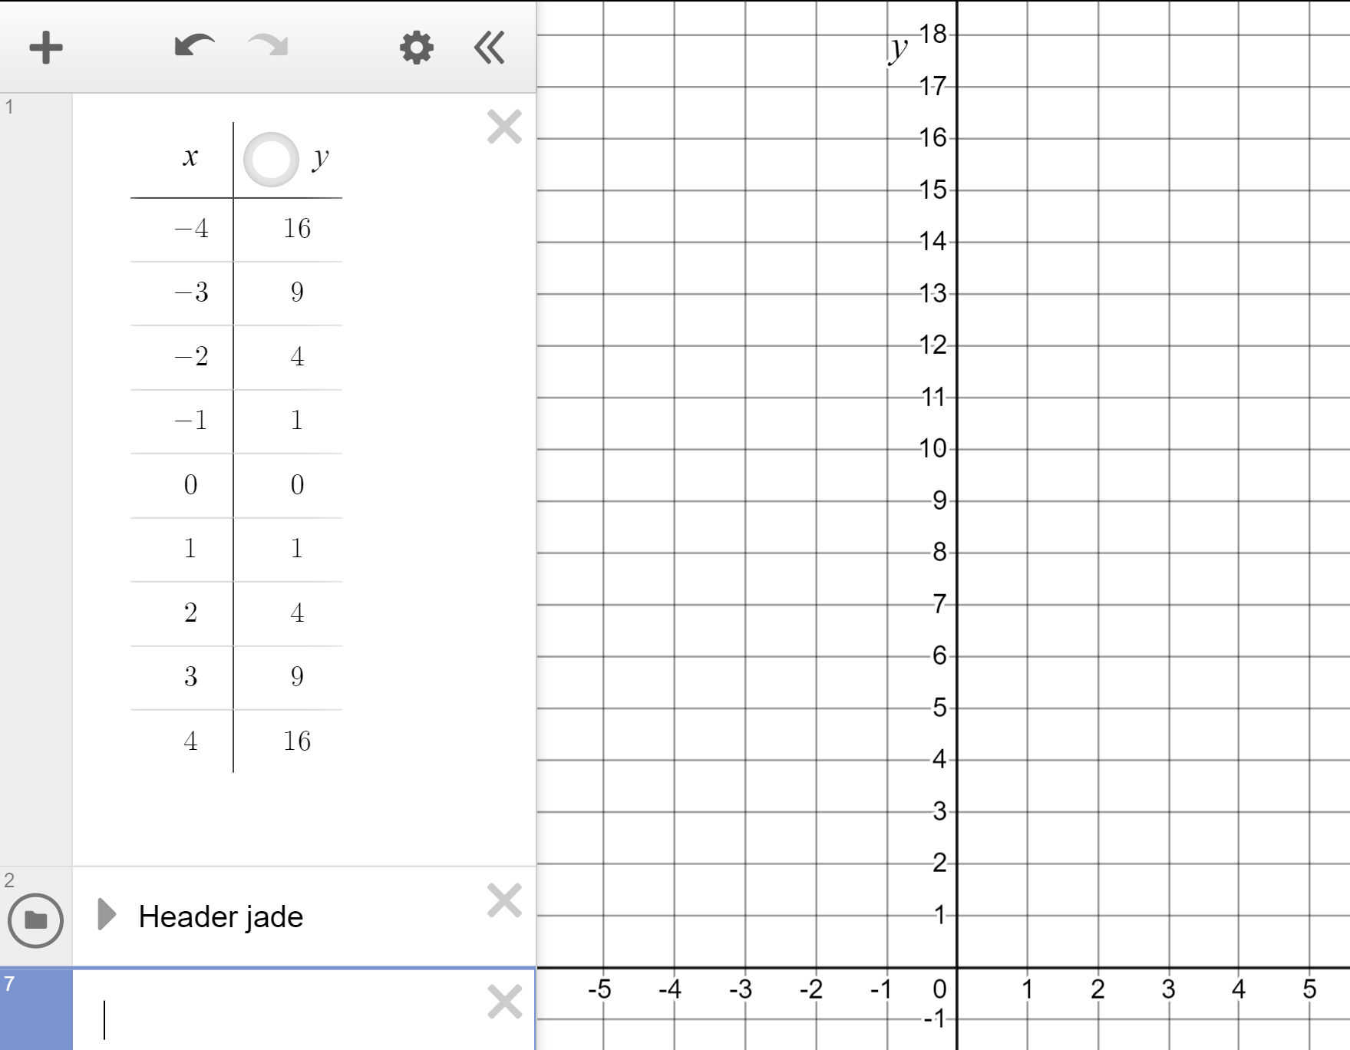
Plotting quadratic graphs
We can plot these coordinates to see how the graph of this looks.
The y-axis is like a line of symmetry reflecting each coordinate.

Slide 36
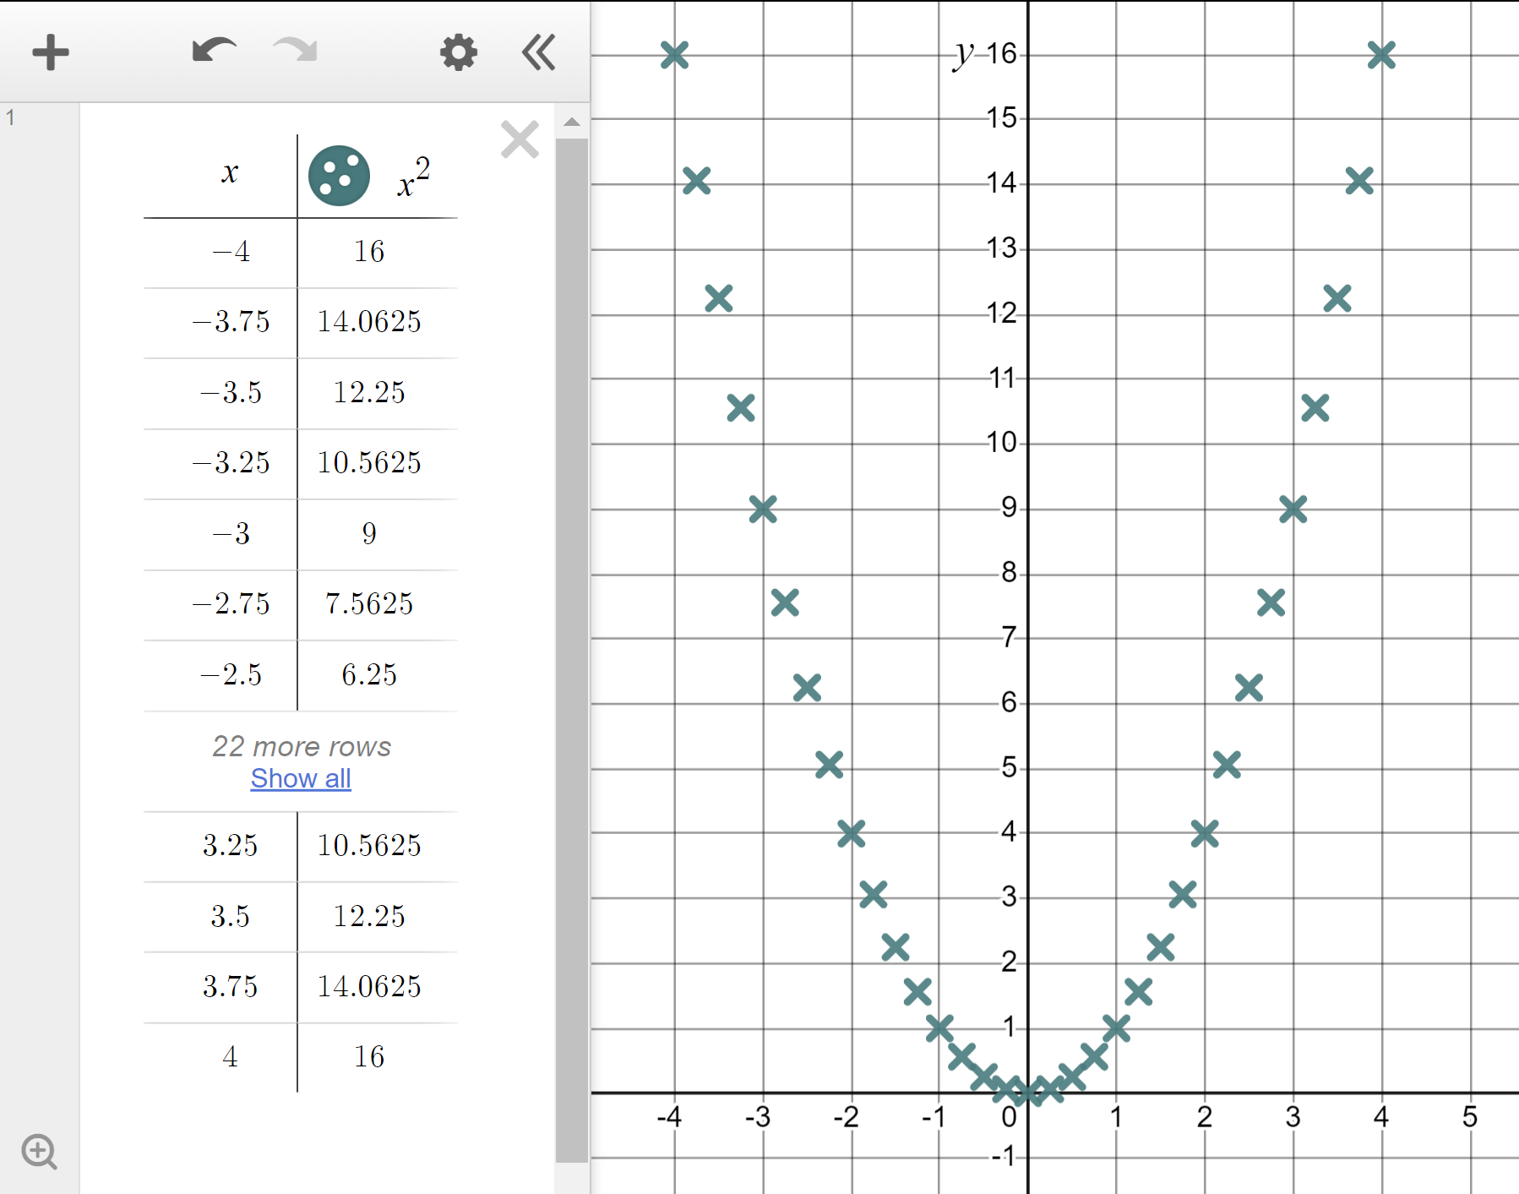
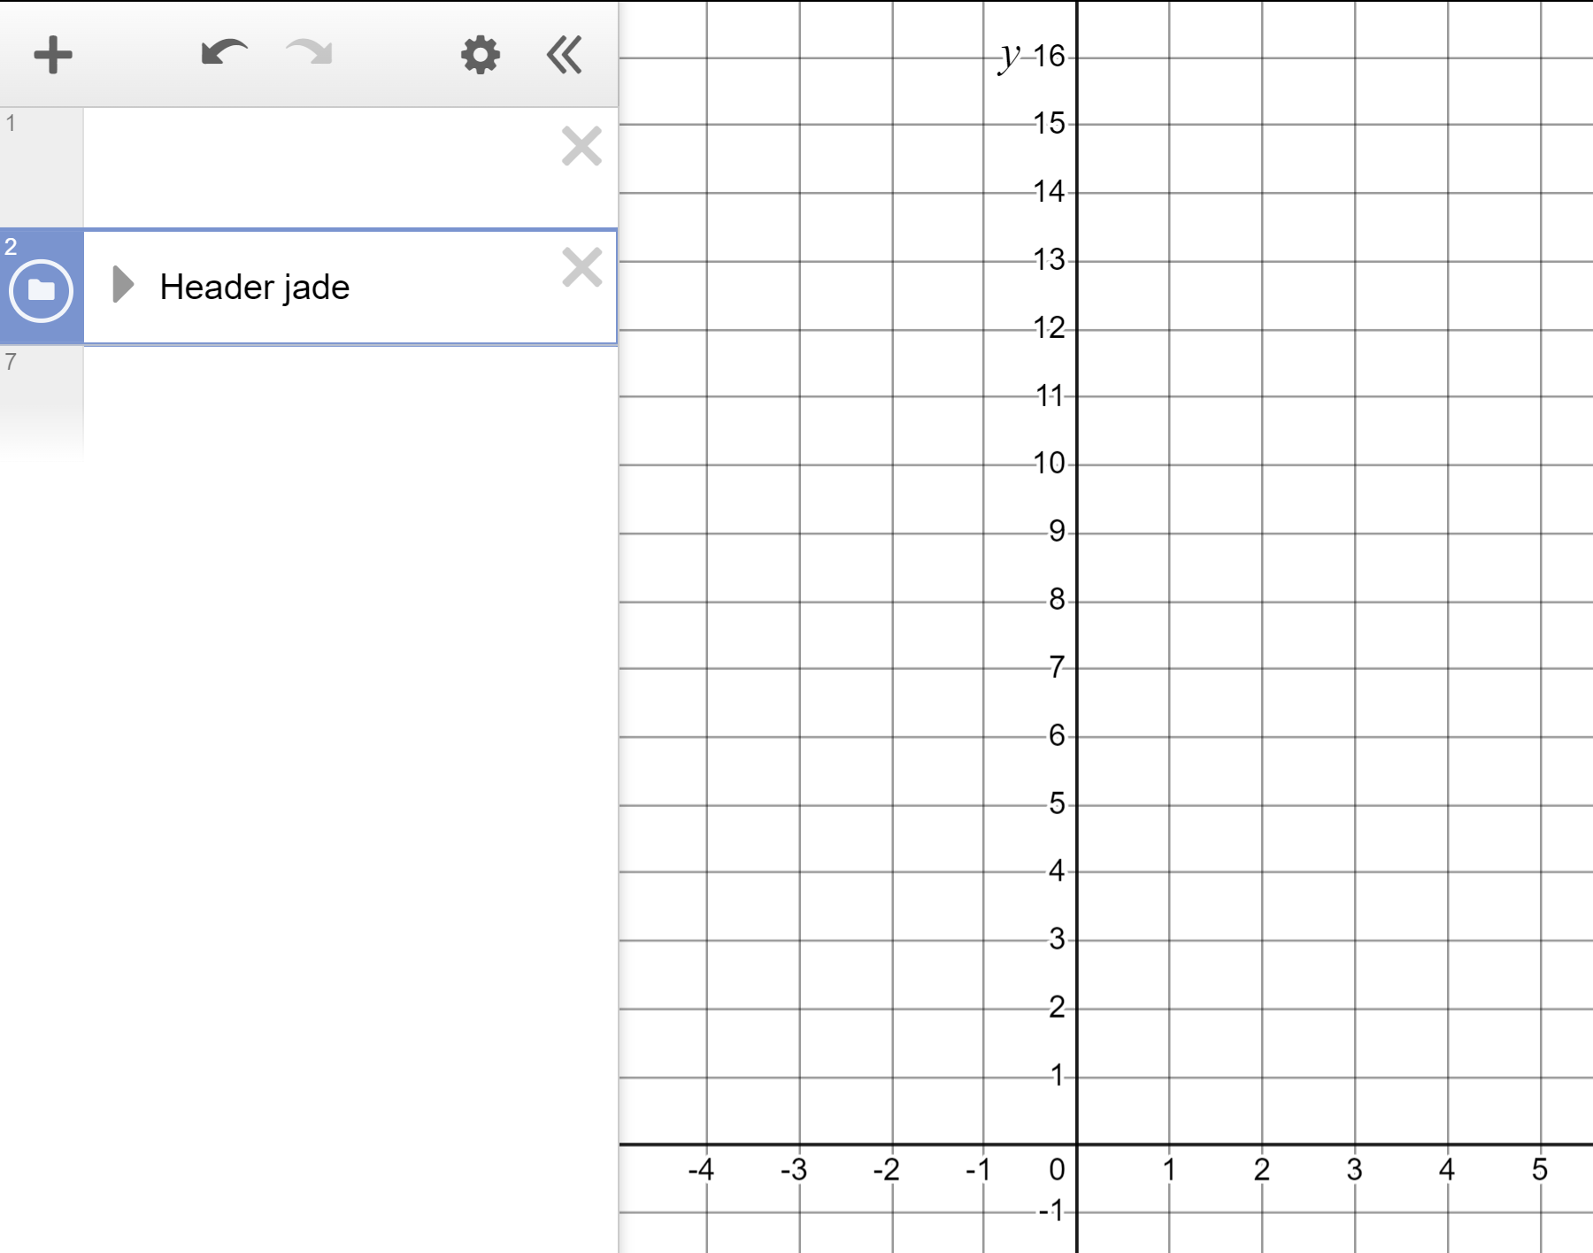
Plotting quadratic graphs
The technology will quickly plot the infinite points of the equation y = x² for us quickly.
Type y = x² in here.
Typing x^2 will generate the x²
^ is ‘shift’ 6 on most keyboards.

Slide 37
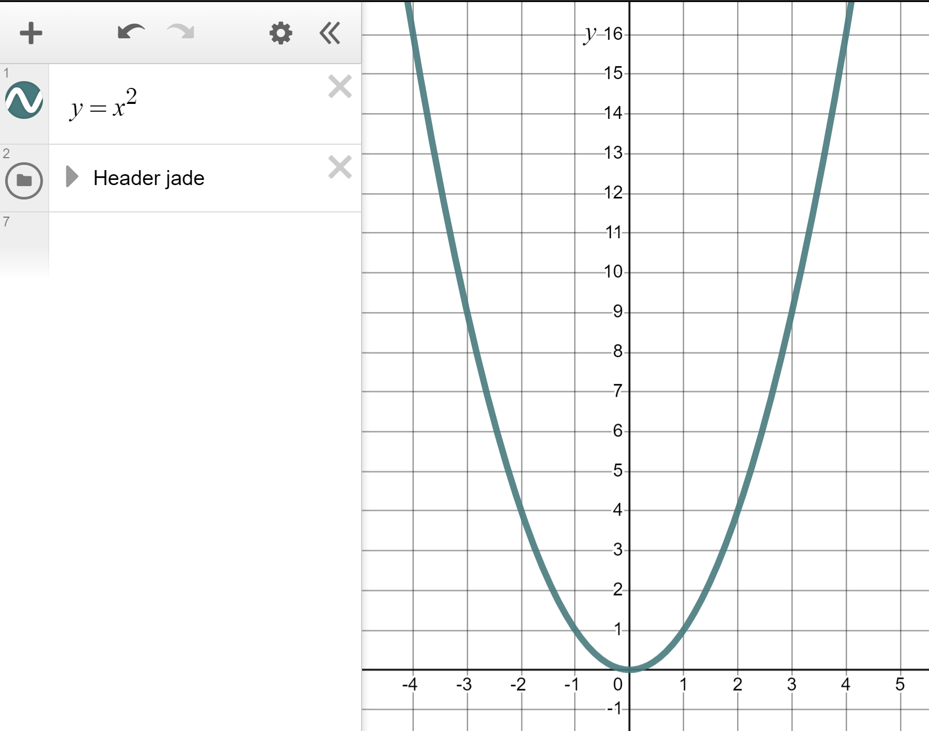
Plotting quadratic graphs
The technology will quickly plot the infinite points of the equation y = x² for us quickly.
The graph y = x² forms a parabola. This is a special curve, symmetrical and bowl-like in appearance.

Slide 38
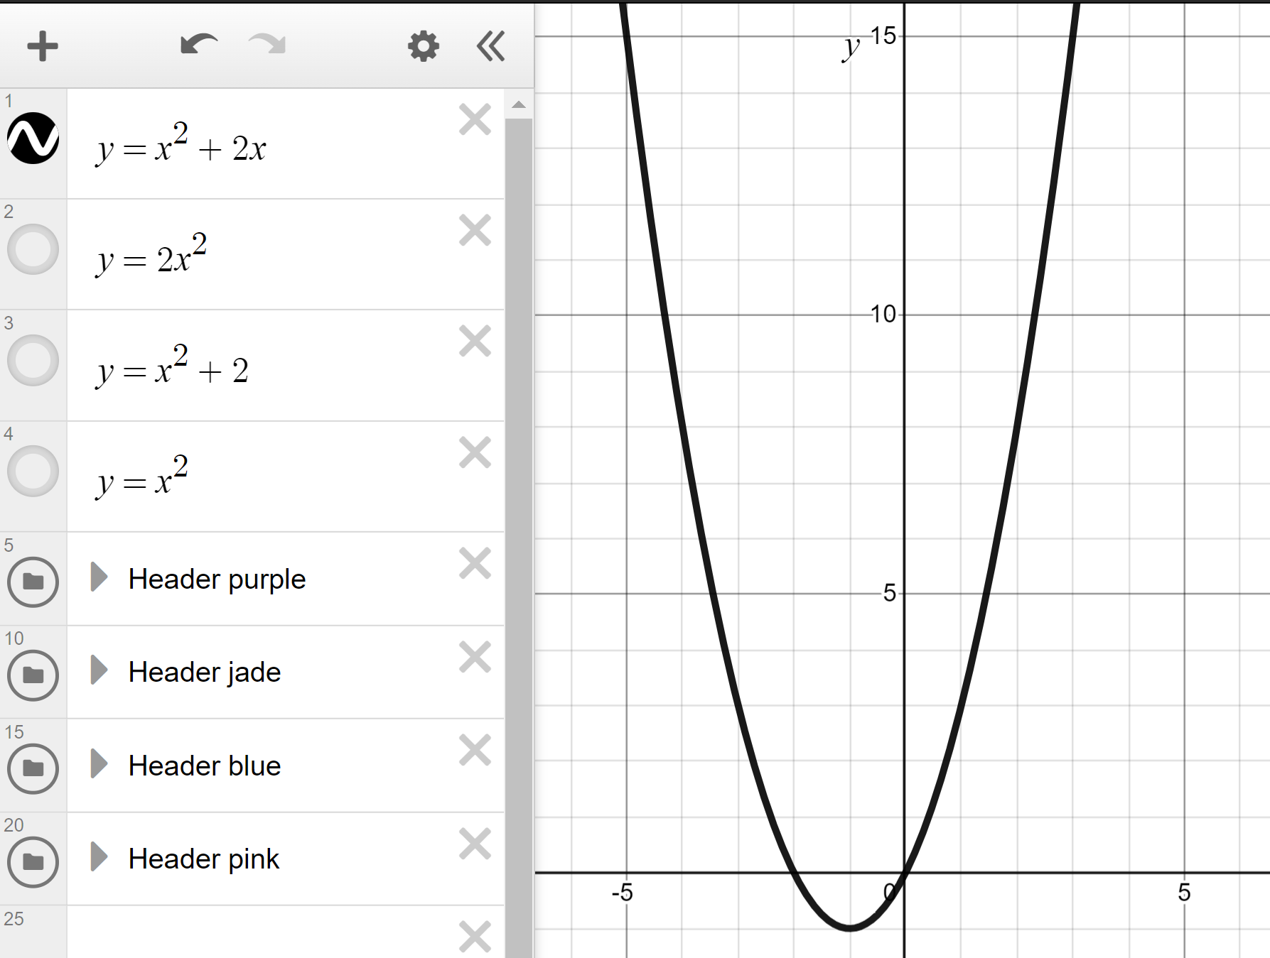
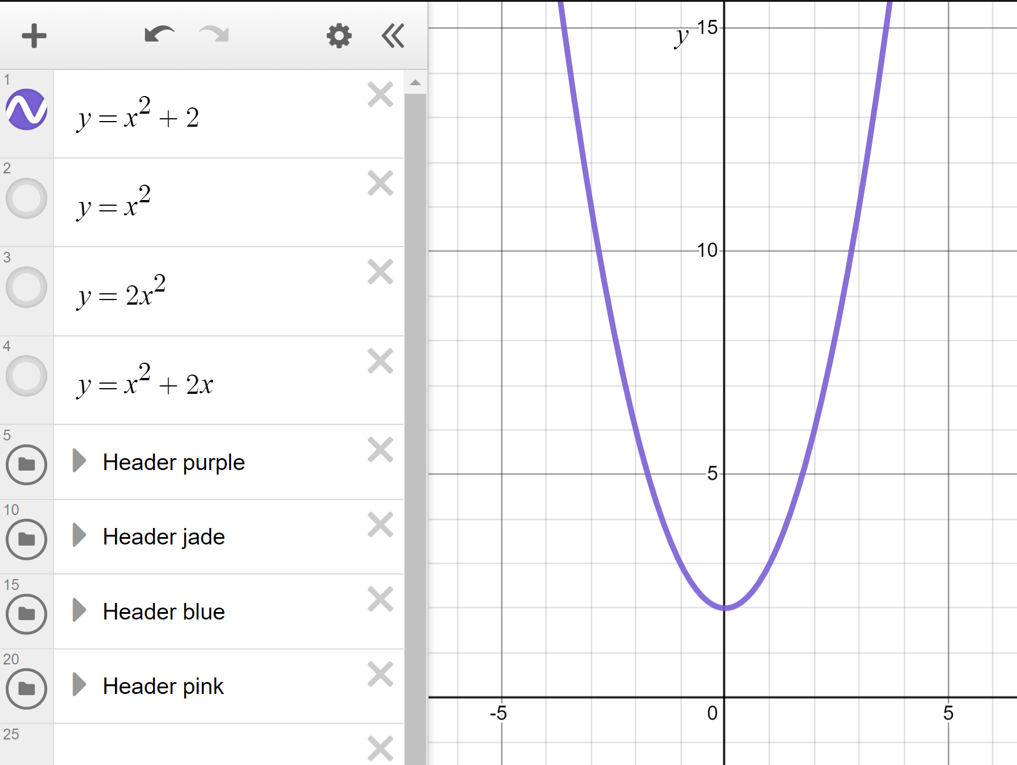
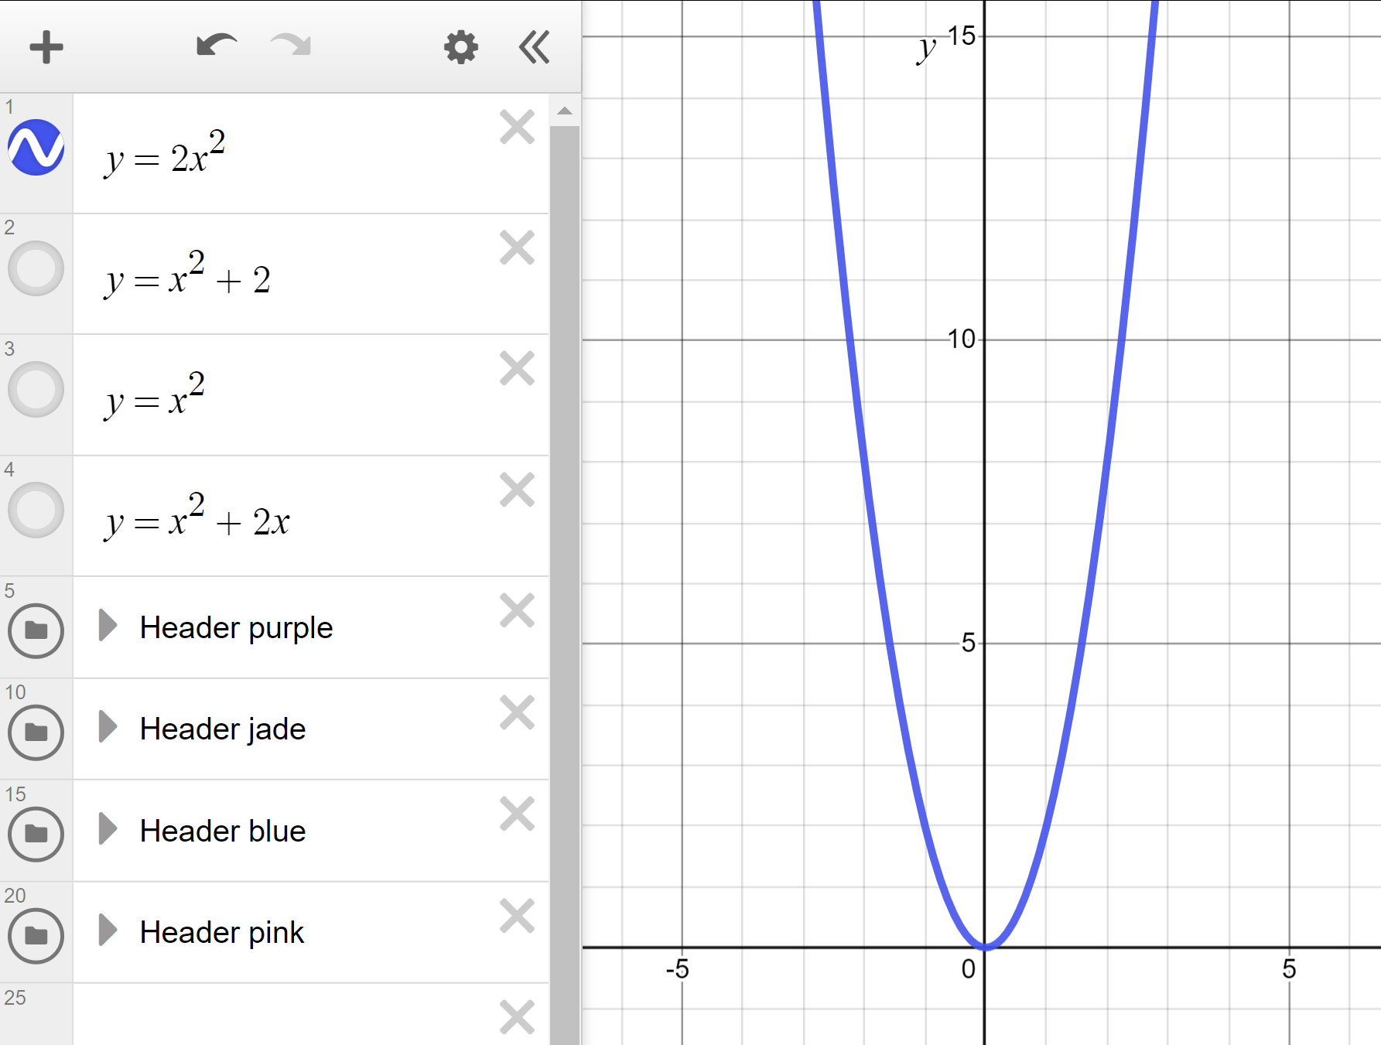
Plotting quadratic graphs
The graph y = x² forms a parabola; a special, symmetrical curve.
Will these graphs form other, different, special shapes?
y = x² + 2
y = 2x²
y = x² + 2x

Slide 39
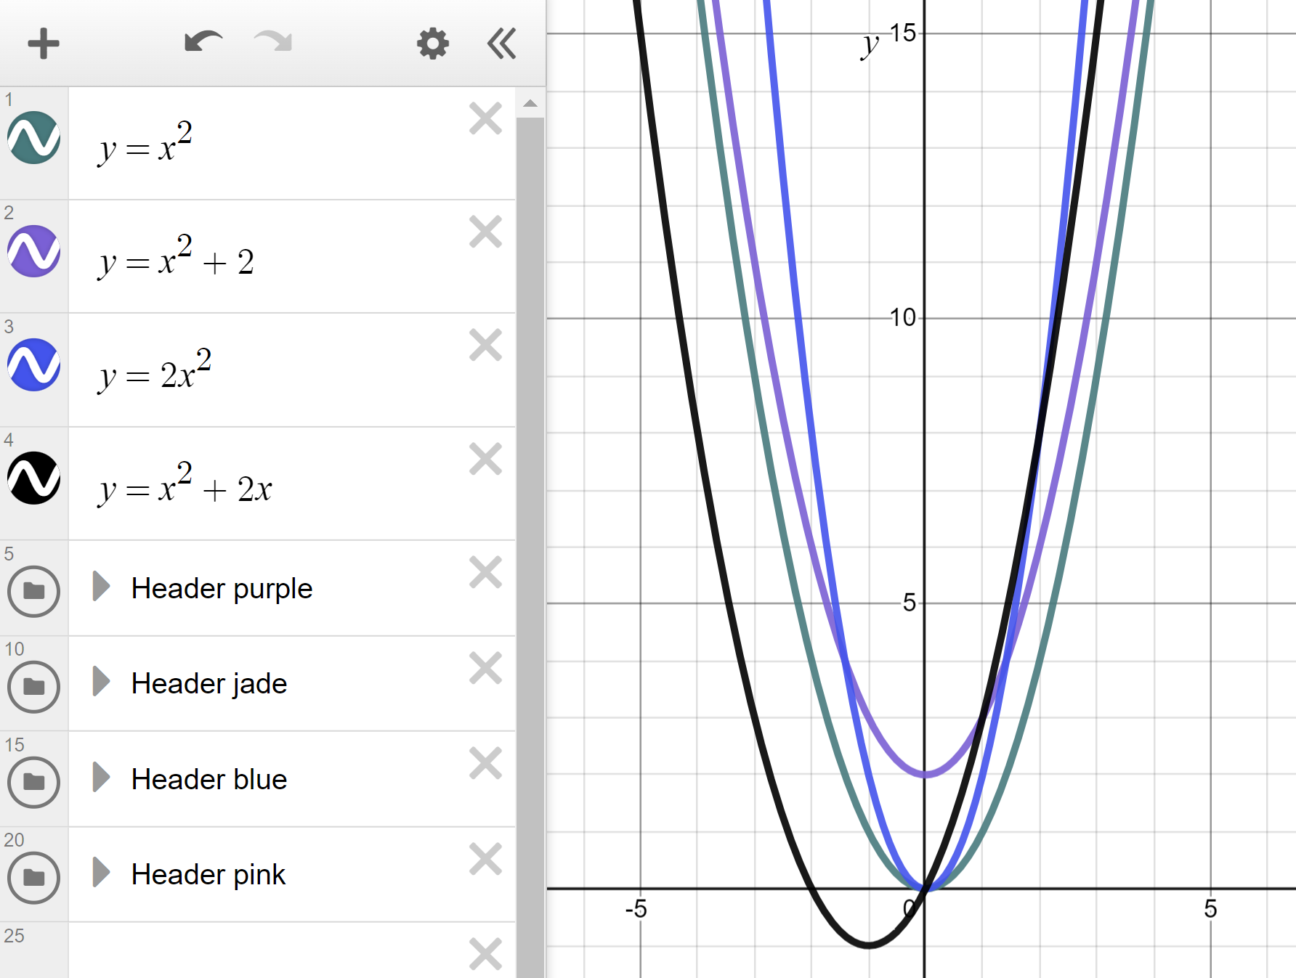
Plotting quadratic graphs
The graph y = x² forms a parabola; a special, symmetrical curve.
Will these graphs form other, different, special shapes?
y = x² + 2
y = 2x²
y = x² + 2x
They all form the same, special shape; a parabola.

Slide 40
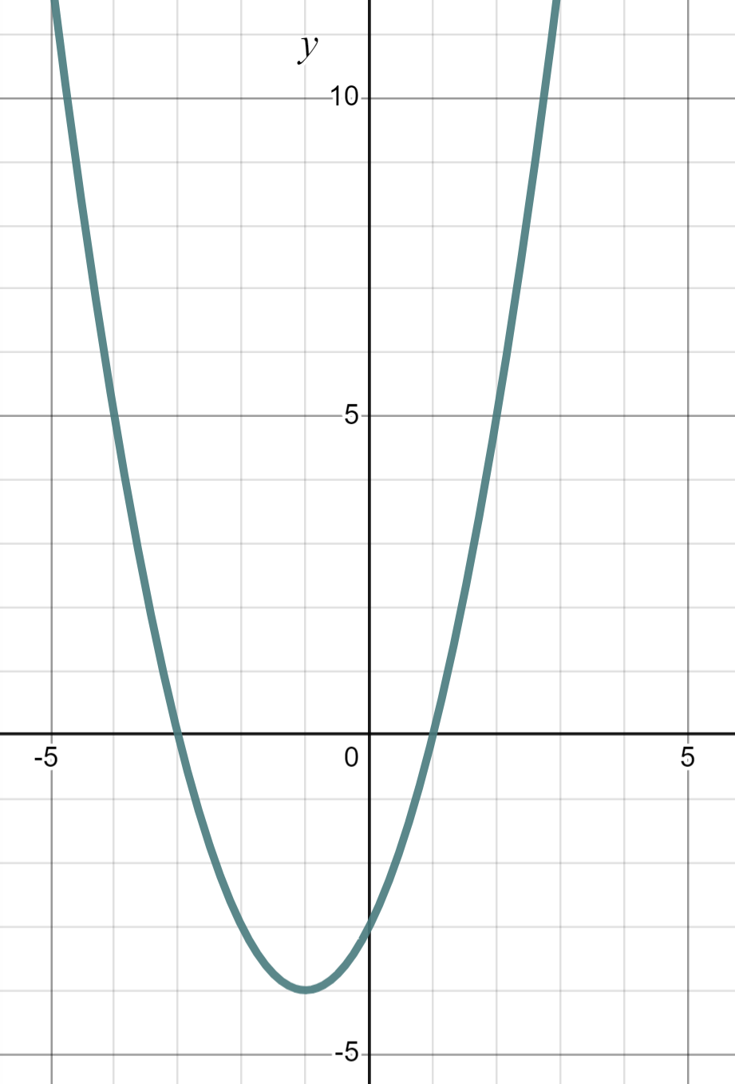


Plotting quadratic graphs
This graph of the line y = x² + 2x − 3 forms a __________.
straight line.
circle.
parabola.

Slide 41
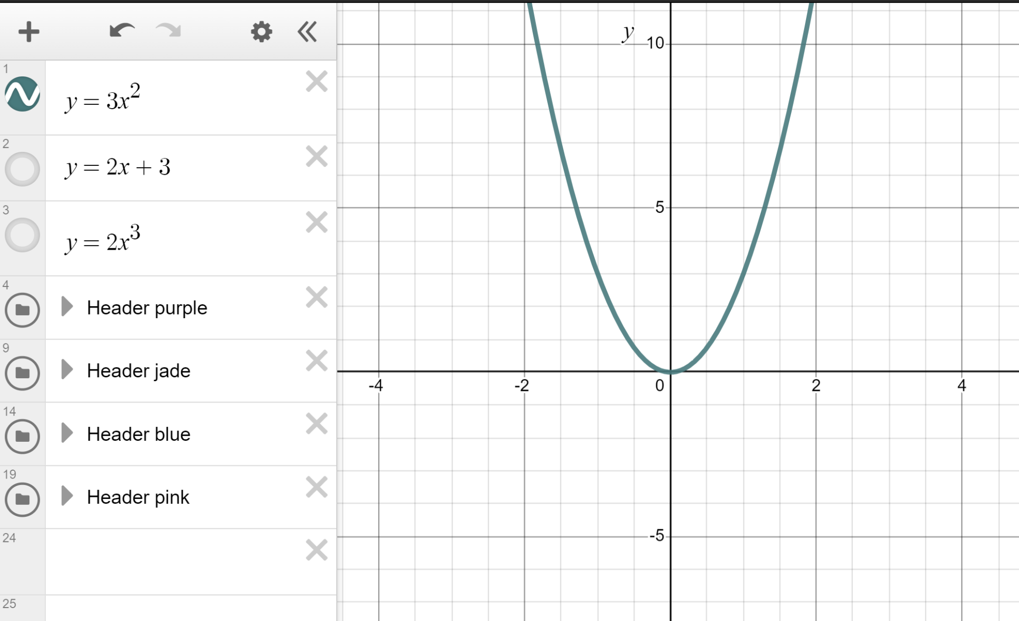
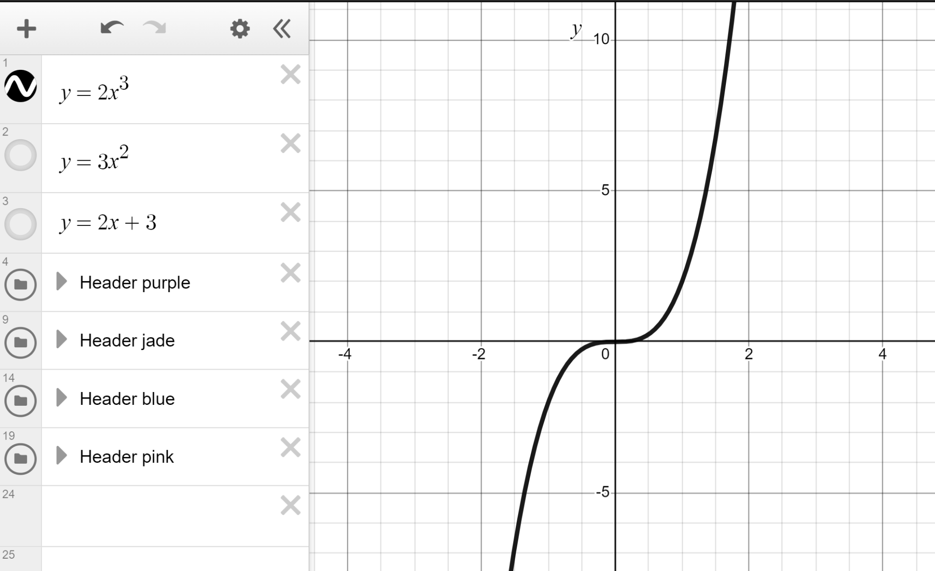

Plotting quadratic graphs
It is a special type of equation which forms a parabola.
What shape do each of these equations make?
y = 2x + 3
Straight line.
y = 3x²
Parabola.
y = 2x³
Cubic curve.

Slide 42
Plotting quadratic graphs
1) Categorise these equations into quadratic, linear, and ‘other’.
a) y = x − 5
b) y = x² − 5
c) y = x⁴ − 5
d) y = x² − x + 5
e) y = x² − 5x
f) y = x² − 5x + 1
g) y = 5 + 2x
h) y = 5 + x²
i) y = x⁵ + x²
j) y = 5(x + 2)
k) y = x(x + 2)
l) y = x(x² + 2)
Hint: Use Desmos to check if you’re unsure. If the graph forms a parabola it is quadratic.

Slide 43
Plotting quadratic graphs
2) Use technology to plot the graphs of these quadratic equations. They all form parabolas. Spot the odd one out.
a) y = x² + 3
b) y = 3 + x²
c) y = x² − 3
d) y = 3 − x²

Slide 44
Plotting quadratic graphs
1) Categorise these equations into quadratic, linear, and ‘other’.
Quadratic
b) y = x² − 5
d) y = x² − x + 5
e) y = x² − 5x
f) y = x² − 5x + 1
h) y = 5 + x²
k) y = x(x + 2)
Linear
a) y = x − 5
g) y = 5 + 2x
j) y = 5(x + 2)
‘Other’
c) y = x⁴ − 5
i) y = x⁵ + x²
l) y = x(x² + 2)

Slide 45



Plotting quadratic graphs
2) Use technology to plot the graphs of these quadratic equations. They all form parabolas. Spot the odd one out.
a) y = x² + 3
b) y = 3 + x²
c) y = x² − 3
d) y = 3 − x²
a) and b) Addition is commutative, hence the same graph.

Slide 46
Plotting quadratic graphs
2) Use technology to plot the graphs of these quadratic equations. They all form parabolas. Spot the odd one out.
a) y = x² + 3
b) y = 3 + x²
c) y = x² − 3
d) y = 3 − x²
You might have said, “c) is the odd one out because it is the only one with a negative y-intercept”.
×

Slide 47
Plotting quadratic graphs
2) Use technology to plot the graphs of these quadratic equations. They all form parabolas. Spot the odd one out.
a) y = x² + 3
b) y = 3 + x²
c) y = x² − 3
d) y = 3 − x²
You might have said,
“d) is the one out. It is upside down”.
Whilst it is very different it is still a parabola. It looks upside down but we would tend to say it “Opens downwards” or is ‘⋂-shaped’. Importantly, we still have a quadratic equation and a parabola.

Slide 48
Exploring the shapes of graphs using technology
Different types of equations give rise to different graph shapes.
Linear equations like y = 5 + 2x form a straight line whereas quadratic equations like y = x² + 3 form a parabola.

Slide 49

© Oak National Academy 2024.
Produced in partnership with Mathematics in Education and Industry.
Licensed on the Open Government Licence v3.0, except where otherwise stated. See Oak terms and conditions.

